Slide 1
Fluently multiply with decimals
KS3 Mastery PD Materials: Exemplified Key Ideas
Materials for use in the classroom or to support professional development discussions
(from 2.1 Arithmetic procedures)
Summer 2021

Slide 2
About this resource
These slides are designed to complement the 2.1 Arithmetic procedures Core Concept document and its associated Theme Overview document 2 Operating on number, both found in the Secondary Mastery Professional Development pages.
These slides re-present the key examples from the Core Concept document so that the examples can be used either directly in the classroom or with a group of teachers. There are prompt questions alongside the examples, and further clarification in the notes.
These slides do not fully replicate the Core Concept document, so should be used alongside it. Reference to specific page numbers, and to other useful NCETM resources, can be found in the notes for each slide.
This slide deck is not designed to be a complete PD session, rather it is a selection of resources that you can adapt and use as needed when planning a session with a group of teachers.

Slide 3


About this resource
The slides are structured as follows:
  The big picture:
    Where does this fit in?
    What do students need to understand?
    Why is this key idea important?
  Prior learning
  Misconceptions
  Exemplified key ideas
  Reflection questions
  Appendices:
    Key vocabulary
    Representations and structure
    Previous and Future learning
    Useful links
The exemplified key idea slides have the following symbols to indicate how they have been designed to be used:
Into the classroom
The examples are presented on these slides so that they could be used in PD, but also directly in the classroom. The notes feature suggested questions and things teachers might consider when using with students.
PD discussion prompts
These slides look at the examples in more detail, with question prompts to promote discussion among maths teachers. The notes feature reference to further information and guidance within the Core Concepts document.

Slide 4
Where does this fit in?
The NCETM has identified a set of six ‘mathematical themes’ within Key Stage 3 mathematics that bring together a group of ‘core concepts’.
The second of these themes is Operating on number, which covers the following interconnected core concepts:
2.1 Arithmetic procedures
2.2 Solving linear equations
Notes:
Linked on this slide is the Theme Overview document of Operating on number. This document includes why it is important, the key underpinning knowledge and links to prior and future learning. There is also guidance about how the five big ideas of Teaching for Mastery relate specifically to this theme.

Slide 5
Where does this fit in?
Within this core concept, 2.1 Arithmetic Procedures, there are five statements of knowledge, skills and understanding.
These, in turn, are broken down into twenty one key ideas. The highlighted key idea is exemplified in this slide deck.
Notes:
For key ideas marked with an asterisk, we exemplified the common difficulties and misconceptions that students might have and included elements of what teaching for mastery may look like. We have provided examples of possible student tasks and teaching approaches.
Within these slides are ‘classroom-ready’ versions of the examples for the key idea that has been highlighted. There are also slides that may be useful for discussion in a professional development session

Slide 6
What do students need to understand?
2.1.2.3 Generalise and fluently use written multiplication strategies to calculate accurately with decimals
Appreciate the limitations of the (standard) written method for multiplying decimals
Use place value to manipulate a calculation involving decimals to an equivalent calculation involving whole numbers
Appreciate the (standard) written method for multiplying two whole numbers can be used as part of the strategy for multiplying decimals
Solve problems where there is more than one answer and there are elements of experimentation, investigation, checking, reasoning, proof, etc
  What prior knowledge might your students already have?
  What language might they use to describe this key idea?
  What questions might you want to ask to assess their prior learning?

Slide 7
Why is this key idea important?
From Key Stage 2, students should bring an understanding of and ability to use standard arithmetic procedures for all four operations with integers and decimals. Work in Key Stage 3 should develop this both conceptually and procedurally by:
  ensuring students have a strong understanding of the mathematical structures that underpin these standard procedures
  ensuring students generalise these standard procedures with integers, extending to use with decimals, and appreciate that the structures are the same
A key feature of the standard algorithm for the multiplication of integers is that it involves sequences of multiplications of single-digit numbers; place-value considerations and the lining up of columns ensure that the product is of the correct order of magnitude.
When using the method with decimals, it is important that the underlying mathematical structure is thoroughly understood, e.g. 300 × 7 000 can be considered as 3 × 100 × 7 × 1 000 = 3 × 7 × 100 × 1 000. This awareness supports informal calculation methods and underpins the columnar methods.
When multiplying decimals, it is important for students to understand, for example, that 0.3 × 0.007 = 3 × 7 × 0.1 × 0.001 and, therefore, how 3 × 7 and 0.3 × 0.007 are connected.
Notes:
A more detailed overview of the core concept of arithmetic procedures can be found on page 2 of the 2.1 Core Concept document.
The background to each key idea is also explored in more detail on the following pages:
2.1.1 Understand and use the structures that underpin addition and subtraction strategies – page 10
2.1.2 Understand and use the structures that underpin multiplication and division strategies – pages 10 and 11
2.1.3 Know, understand and use fluently a range of calculation strategies for addition and subtraction of fractions – page 11
2.1.4 Know, understand and use fluently a range of calculation strategies for multiplication and division of fractions – pages 11 and 12
2.1.5 Use the laws and conventions of arithmetic to calculate efficiently – pages 12 and 13

Slide 8
Prior learning
Upper Key Stage 2 Learning Outcome
Multiply and divide whole numbers and those involving decimals by 10, 100 and 1 000
Multiply multi-digit numbers up to four digits by a two-digit whole number using the formal written method of long multiplication
Divide numbers up to four digits by a two-digit whole number using the formal written methods of long or short division, and interpret remainders as whole number remainders, fractions, or by rounding, as appropriate for the context
Use their knowledge of the order of operations to carry out calculations involving the four operations
Solve problems involving addition, subtraction, multiplication and division
Use negative numbers in context, and calculate intervals across zero
  What prior knowledge might your students already have?
  What language might they use to describe this key idea?
  What questions might you want to ask to assess their prior learning?
Notes:
You may find it useful to speak to your partner schools to see how the above has been covered and the language used.
The prior learning is covered in a number of the segments from Spines 1, 2 and 3 of the NCETM primary mastery professional development materials (linked on final slide):
Within the 2 Operating on number Theme Overview document, you can also find a broader description of students’ potential previous learning (page 6), alongside further information about key underpinning knowledge (page 2). More detail about the prior learning objectives from KS2 can also be found on pages 2 and 3 of the 2.1 Core Concept document.

Slide 9
Checking prior learning
The following slides contain questions for checking prior learning.
  What representations might students use to support their understanding of these questions?
  What variation might you put in place for these questions to fully assess students’ understanding of the concept?
  How might changing the language of each question change the difficulty?
  Why are these such crucial pre-requisites for this key idea?

Slide 10
Checking prior learning (1)
a)
5 4 1 3
× 8 6
Find numbers to complete these number sentences.
736 ÷ 23 =
× 100 = 2 400
× 100 = 10 ×
7 360 ÷ 230 =
25 × = 200
25 × = 4 ×
230 × 24 =
23 × = 161
23 × = 161 ×
240 × 23 =
24 × = 168
24 × = 168 ×
1 668 ÷ 8 =
161 ÷ = 23
161 ÷ = 23 ×
208.5 × 8 =
÷ 25 = 9
÷ 25 = 9 ×
Notes:
References to the questions (links on final slide):
a) 2018 Key Stage 2 Mathematics Paper 1: arithmetic, Question 29
b) NCETM Primary assessment materials: Year 6, page 15

Slide 11
Checking prior learning (2)
c)
Put these numbers in order from smallest to largest
5834, 61·8 multiplied by 100, one tenth of 45813
0·034, 3·6 divided by 100, ten times 0·0033
d)
It is correct that 273 × 32 = 8736. Use this fact to work out:
27.3 × 3.2
2.73 × 32000
873.6 ÷ 0.32
87.36 ÷ 27.3
8736 ÷ 16
4368 ÷ 1.6
Notes:
References to the questions (links on final slide):
c) NCETM Primary assessment materials: Year 6, page 10
d) NCETM Primary assessment materials: Year 6, page 16

Slide 12
Common difficulties and misconceptions
What aspects of this key idea might students find challenging?
What misconceptions might students have?
When teaching this topic, you may find students encounter difficulties with…
Using the standard written algorithm, and not considering the mathematical structure of related integer calculations
More information, and some suggestions for overcoming these challenges, can be found on the following slides

Slide 13
Common difficulties and misconceptions (1)
Although students should be proficient with the standard written multiplication algorithm for calculating with whole numbers in KS2, students do not always make the connection with using the standard written multiplication algorithm for calculating with decimals in KS3.
Some students will try to use the standard written algorithm with decimals. This can give the correct answer if the multiplier is a whole number (see example 1 on the next slide) but soon fails with decimal multipliers (see example 2 on the next slide).
Students see multiplying decimals as ‘new’ learning rather than thinking about the underlying mathematical structure of a calculation such as 24.3 x 1.2 = (243 x 12) x 0.1 x 0.1 or (243 x 12) ÷ 10 ÷ 10
Using ‘If I know … then I also know …’ mathematical thinking empowers students to understand if they know 243 x 12 = 2916 then they also can find the product of other calculations such as 24.3 x 1.2, 2.43 x 0.12, 0.243 x 1.2, etc. Avoiding mechanical practice of exclusively standard questions by varying the value of the multiplicand* and multiplier is explored further in Examples 2, 3 and 4 on the following slides.
Notes:
More detail, including a visual representation of the 24.3 x 1.2, can be found on page 29 of the 2.1 Core Concept document.
It is also useful to include some non-example (see examples 1 and 6) for students to critique and reason about as well. Students should be encouraged to estimate the product first to check they have transformed the calculation correctly using powers of 10.
*Multiplicand is a quantity which is to be multiplied by another (the multiplier).

Slide 14
Appreciate the limitations of the (standard) written method for multiplying decimals
Example 1
Richard thinks 4.56 x 3 = 13.68 because:
Nicola thinks 2.5 x 1.1 = 27.5 because:
4.56
x 3
13.68
2.5
x 1.1
2.5
25.0
27.5
¹ ¹
Use estimation to explore if Richard and Nicola are both correct.
Notes:
Suggested questioning:
What does ‘estimation’ mean?
What would you estimate to be the answer to each question?
Could you change the incorrect answer to be correct? What have you done to achieve this?
Things for you to think about:
The ‘what it’s not’ calculations in Example 1 have been chosen to support students’ awareness that the standard written algorithm for multiplying whole numbers (short/long multiplication) can not be applied to calculations with decimals, in particular when the multiplier is a decimal number in the case of Nicola. Students need to be encouraged to give meaning to the idea that calculations such as 4.56 x 3 and 2.5 x 1.1 can be calculated as (456 x 3) ÷ 100 and (25 x 11) ÷ 100.

Slide 15
Appreciate the limitations of the (standard) written method for multiplying decimals
Example 1
Richard thinks
4.56 x 3 = 13.68 because:
Nicola thinks
2.5 x 1.1 = 27.5 because:
  Why does ‘lining up’ the decimal point work in the standard columnar written methods for addition and subtraction of decimal number but not for multiplication?
  What is the department/school’s calculation policy for multiplying (and dividing) whole numbers?
4.56
x 3
13.68
2.5
x 1.1
2.5
25.0
27.5
¹ ¹
Use estimation to explore if Richard and Nicola are both correct.
Notes:
This example can be found on pages 29 and 30 of the 2.1 Core Concept document.

Slide 16
Use place value to manipulate a calculation involving decimals to an equivalent calculation involving whole numbers
Example 2
Given 456 x 12 = 5 472, work out:
  45.6 x 12
  4.56 x 12
  45.6 x 1.2
  4.56 x 1.2
  4.56 x 0.12
Notes:
Suggested questioning:
What is the same, and what is different, about these calculations?
If you know __, what else do you know?
What operation are you doing to the original product to work out the answer to…?
What other products could you know from this product?
Things for you to think about:
Example 2 draws attention to the digits in a calculation rather than the individual numbers. Asking ‘what is the same and what is different?’ about the five calculations encourages students to notice the connections between the calculations and encourage a ‘if I know … then I also know …’ way of thinking. Students’ thinking can be deepened by asking more probing questions such as use 456 x 12 = 5,472 to find the products of other pairs of numbers.

Slide 17
Use place value to manipulate a calculation involving decimals to an equivalent calculation involving whole numbers
Example 2
  Students need to be confident and fluent with multiplying and dividing by powers of 10. How could you assess this before starting on this example?
  What other concepts might be usefully explored through the structure of “If I know…, then I also know…”?
Given 456 x 12 = 5 472, work out:
  45.6 x 12
  4.56 x 12
  45.6 x 1.2
  4.56 x 1.2
  4.56 x 0.12
Notes:
This example can be found on page 30 of the 2.1 Core Concept document.

Slide 18


Appreciate the (standard) written method for multiplying two whole numbers can be used as part of the strategy for multiplying decimals
Example 3
Fill in the gaps.
2 4 5
× 1.3
2 4 5
× 1 3
3
2 4 5 0
3 8
$$×$$
$$÷$$
245 × 1.3 = .
Notes:
Suggested questioning:
What is the same, and what is different about the two column multiplications here?
What are the missing numbers?
What operation has happened between the two calculations?
Things for you to think about:
Examples 3 and 4 are empty box problems to support students understand how the standard written method for multiplying whole numbers can be used as part of the strategy for multiplying decimals. The digits in the calculations in Example 3 have been deliberately chosen to reduce cognitive load, e.g partial products such as 8 x 7 are not included. Do we think carefully about the number choice in examples to ensure students can focus on the structure and conceptual understanding and prevent any unnecessary barriers to learning?

Slide 19
Appreciate the (standard) written method for multiplying two whole numbers can be used as part of the strategy for multiplying decimals
Example 4
Fill in the gaps.
2 4.5
× 1.3
2 4 5
× 1 3
$$×$$
$$÷$$
24.5 × 1.3 = .
Notes:
Suggested questioning:
What is the same, and what is different about the two column multiplications here?
How has this changed from example 3?
What are the missing numbers?
What operation has happened between the two calculations?
Things for you to think about:
Examples 3 and 4 are empty box problems to support students understand how the standard written method for multiplying whole numbers can be used as part of the strategy for multiplying decimals. Changing the nature of the multiplicand in the Example 4 to a decimal number supports students noticing the equivalent calculation is (326 x 21) ÷ 100 and not (326 x 21) ÷ 100 as is the case in Example 3. Consider how you might use the two examples consecutively, and the effect of the variation in focussing students’ attention on the differences between them.

Slide 20
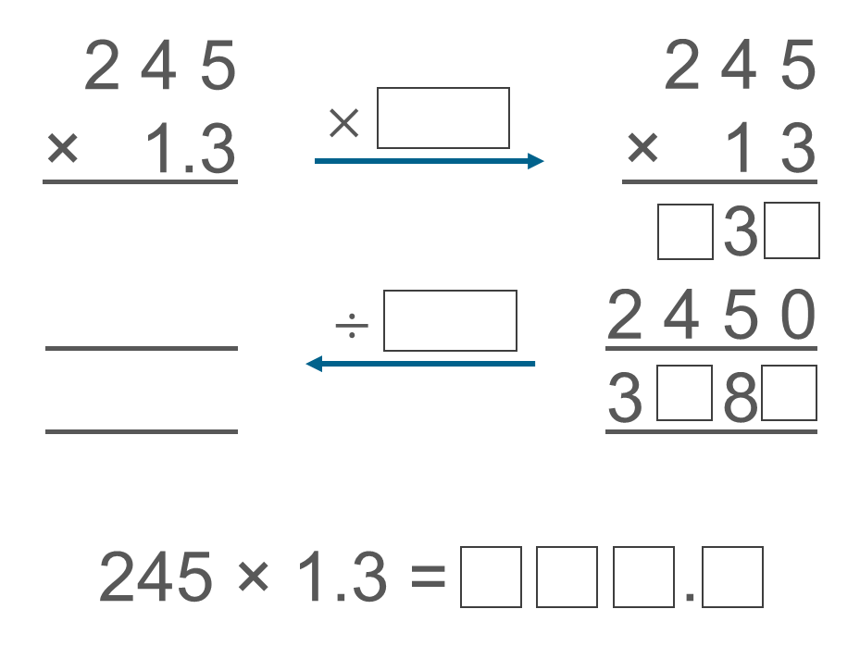
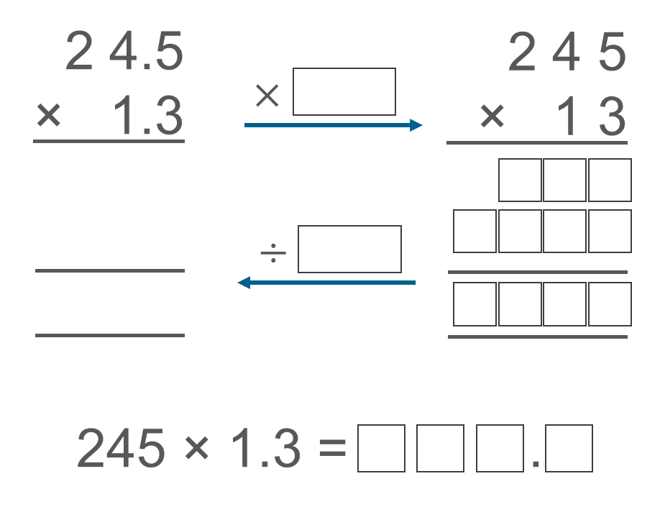
Appreciate the (standard) written method for multiplying two whole numbers can be used as part of the strategy for multiplying decimals
Example 3
Example 4
Look at the number choice in the examples here: how might they ensure students can focus on the structure and build conceptual understanding?
Reflect on the choice of number in the examples you use in teaching: how can you prevent any unnecessary barriers to learning?
Fill in the gaps.
Fill in the gaps.
Notes:
Due to space constraints, the image on this PD discussion slide is very small. PD Leads might like to use or print the ‘in the classroom’ version of this slide for teachers to access during discussions.
These examples can be found on page 31 of the 2.1 Core Concept document.

Slide 21
Appreciate the (standard) written method for multiplying two whole numbers can be used as part of the strategy for multiplying decimals
Example 5
Tick the correct calculations:
A: 52.4 x 1.6 = 524 x 16
B: 52.4 x 1.6 = 524 x 16 ÷ 10
C: 52.4 x 1.6 = 524 x 16 ÷ 100
D: 5.24 x 1.6 = 524 x 16 ÷ 1000
E: 0.524 x 1.6 = 524 x 16 ÷ 1000
Notes:
Suggested questioning:
What is the same and what is different about the sets of calculations here?
How could you correct the ones that aren’t correct?
Could you write another calculation using these digits that gives the same answer?
Things for you to think about:
Example 5 draws students attention to transforming a calculation such as 5.24 x 1.6 by multiplying and dividing by the correct power of 10 by noticing the number of decimal places in both the multiplicand and the multiplier

Slide 22
Appreciate the (standard) written method for multiplying two whole numbers can be used as part of the strategy for multiplying decimals
Example 5 (cont)
Predict the number of decimal places in the product of:
i) 2.45 x 1.3
ii) 2.45 x 0.13
iii) 0.245 x 0.13
Notes:
Suggested questioning:
How many decimal places do you expect? Why?
Things for you to think about:
This extension to example 5 provides an opportunity to deepen students’ thinking by asking them to predict the number of decimal places and explain their reasoning. Students may offer shortcuts or tricks, such as counting the number of digits after the decimal point: consider how you might encourage them to use the language and reasoning of dividing by powers of 10 (as in the first part of example 5, on the previous slide).

Slide 23
Appreciate the (standard) written method for multiplying two whole numbers can be used as part of the strategy for multiplying decimals
Example 5
Tick the correct calculations:
  What misconceptions might you need to unpick if students thought A, B or E were correct?
  Why might it be beneficial to show students incorrect calculations?
  What representations might you use to support your modelling of this example?
A: 52.4 x 1.6 = 524 x 16
B: 52.4 x 1.6 = 524 x 16 ÷ 10
C: 52.4 x 1.6 = 524 x 16 ÷ 100
D: 5.24 x 1.6 = 524 x 16 ÷ 1000
E: 0.524 x 1.6 = 524 x 16 ÷ 1000
Notes:
This example can be found on page 31 of the 2.1 Core Concept document.

Slide 24
Solve problems where there is more than one answer and there are elements of experimentation, investigation, checking, reasoning, proof, etc
Example 6
Are the following statements always true, sometimes true or never true?
Explain your thinking.
A: The product of two decimals is a decimal number
B: The product of two decimal numbers with 2 decimal places has 4 decimal places.
C: The product of two decimal numbers is smaller than the multiplicand.
Notes:
Suggested questioning:
Can you think of an example? Can you think of a counter example?
Why might someone think C is never true? How could you convince them otherwise?
Things for you to think about:
Statements such as the ones in Example 6 provide opportunities for students to ‘play’ and conjecture when multiplying decimals and explore the structure to greater depth. Students should be encouraged to think about simpler calculations that, such as 0.2 x 0.4, 0.25 x 1, as well as more complex calculations that need a written method. Statement C provides students with an opportunity to explore multiplying by a number between 0 and 1.

Slide 25
Solve problems where there is more than one answer and there are elements of experimentation, investigation, checking, reasoning, proof, etc
Example 6
  How do you manage a task like this with your classes?
  How long would you give them before you intervene and support?
  What prompts could you give?
Are the following statements always true, sometimes true or never true?
Explain your thinking.
A: The product of two decimals is a decimal number
B: The product of two decimal numbers with 2 decimal places has 4 decimal places.
C: The product of two decimal numbers is smaller than the multiplicand.
Notes:
This example can be found on page 32 of the 2.1 Core Concept document.

Slide 26
Reflection questions
What other mathematical concepts will be supported by students’ stronger understanding of this key idea?
What mathematical language will you continue to use to support pupils to make connections with other areas?
Which representations might you continue to use to further develop students’ understanding?

Slide 28
Appendices
You may choose to use the following slides when planning or delivering a PD session. They cover:
  Key vocabulary
  Representations and structure
  Previous learning
  Future learning
  Library of links

Slide 29
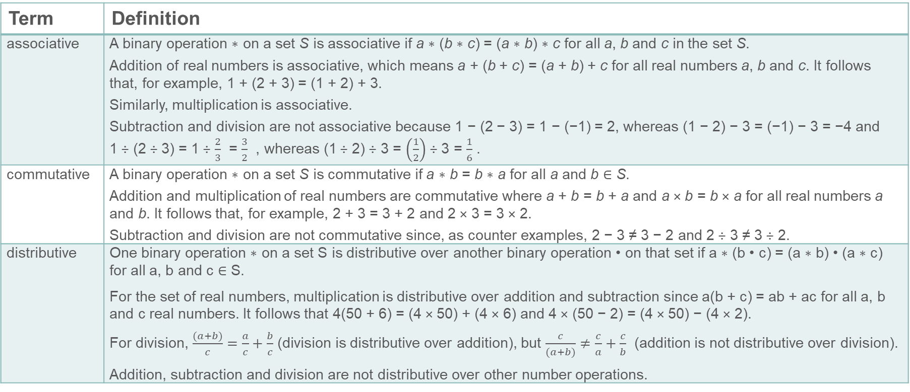
Key vocabulary (1)
Term | Definition
associative | A binary operation ∗ on a set S is associative if a ∗ (b ∗ c) = (a ∗ b) ∗ c for all a, b and c in the set S. Addition of real numbers is associative, which means a + (b + c) = (a + b) + c for all real numbers a, b and c. It follows that, for example, 1 + (2 + 3) = (1 + 2) + 3. Similarly, multiplication is associative. Subtraction and division are not associative because 1 − (2 − 3) = 1 − (−1) = 2, whereas (1 − 2) − 3 = (−1) − 3 = −4 and 1 ÷ (2 ÷ 3) = 1 ÷ $\frac{2}{3}$ = $\frac{3}{2}$ , whereas (1 ÷ 2) ÷ 3 = $\left(\frac{1}{2}\right)$ ÷ 3 = $\frac{1}{6}$ .
commutative | A binary operation ∗ on a set S is commutative if a ∗ b = b ∗ a for all a and b ∈ S. Addition and multiplication of real numbers are commutative where a + b = b + a and a × b = b × a for all real numbers a and b. It follows that, for example, 2 + 3 = 3 + 2 and 2 × 3 = 3 × 2. Subtraction and division are not commutative since, as counter examples, 2 − 3 ≠ 3 − 2 and 2 ÷ 3 ≠ 3 ÷ 2.
distributive | One binary operation ∗ on a set S is distributive over another binary operation • on that set if a ∗ (b • c) = (a ∗ b) • (a ∗ c) for all a, b and c ∈ S. For the set of real numbers, multiplication is distributive over addition and subtraction since a(b + c) = ab + ac for all a, b and c real numbers. It follows that 4(50 + 6) = (4 × 50) + (4 × 6) and 4 × (50 − 2) = (4 × 50) − (4 × 2). For division, $\frac{(a+b)}{c}=\frac{a}{c}+\frac{b}{c}$ (division is distributive over addition), but $\frac{c}{(a+b)}≠\frac{c}{a}+\frac{c}{b}$ (addition is not distributive over division). Addition, subtraction and division are not distributive over other number operations.

Slide 30
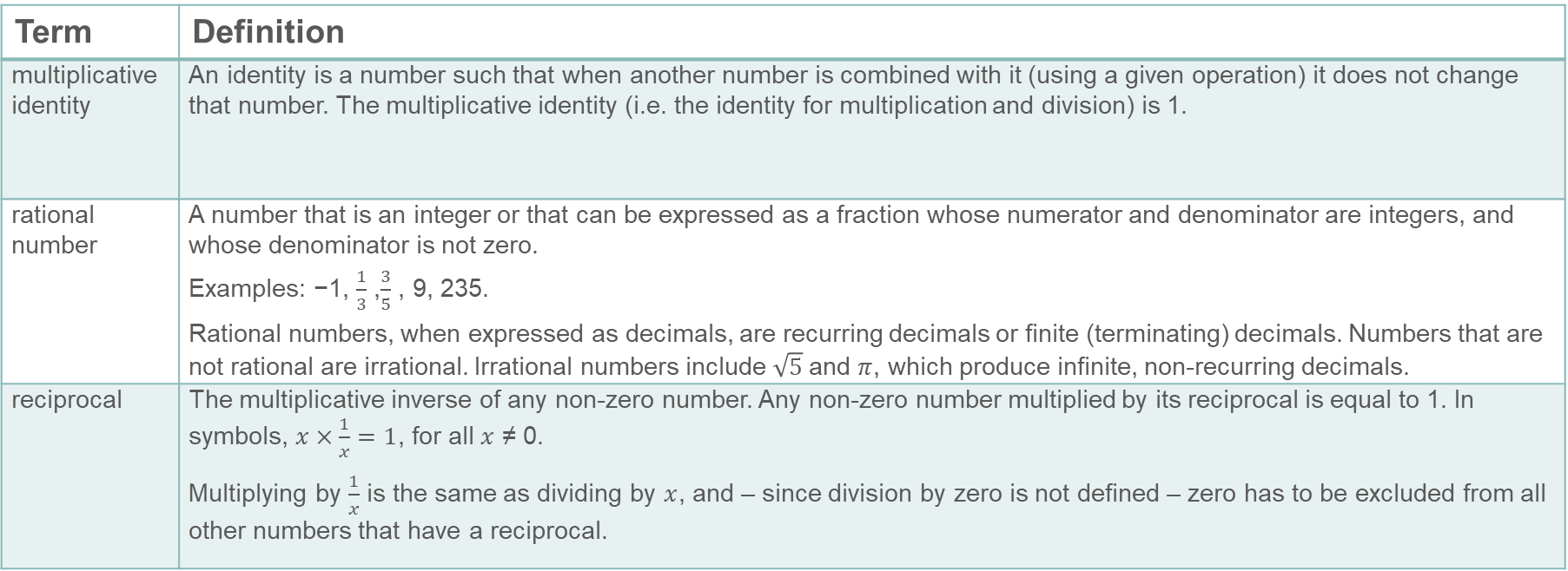
Key vocabulary (2)
Term | Definition
multiplicative identity | An identity is a number such that when another number is combined with it (using a given operation) it does not change that number. The multiplicative identity (i.e. the identity for multiplication and division) is 1.
rational number | A number that is an integer or that can be expressed as a fraction whose numerator and denominator are integers, and whose denominator is not zero. Examples: −1, $\frac{1}{3}$ ,$\frac{3}{5}$ , 9, 235. Rational numbers, when expressed as decimals, are recurring decimals or finite (terminating) decimals. Numbers that are not rational are irrational. Irrational numbers include $\sqrt{5}$and $π$, which produce infinite, non-recurring decimals.
reciprocal | The multiplicative inverse of any non-zero number. Any non-zero number multiplied by its reciprocal is equal to 1. In symbols, $x×\frac{1}{x}=1$, for all $x$ ≠ 0. Multiplying by $\frac{1}{x}$ is the same as dividing by $x$, and – since division by zero is not defined – zero has to be excluded from all other numbers that have a reciprocal.

Slide 31

Representations and structure
There are a number of different representations that you may wish to use to support students’ understanding of this key idea. These might include:
Arrays and area models
  The array is a useful image for revealing the commutative and distributive properties of multiplication. When the rectangle has continuous measures for the dimensions, it becomes a useful way of thinking about the product of any two numbers including decimals and fractions.
.
Notes:
More information about the representations and structure involved in this key idea can be found:
On page 11 and 12 of the Theme Overview document.
In the ‘Using mathematical representations at KS3’ documents
Links to all of these can be found on the final slide.

Slide 32
Previous learning (1)
From Upper Key Stage 2, students will bring experience of:
multiplying multi-digit numbers up to four digits by a two-digit whole number using the formal written method of long multiplication
dividing numbers up to four digits by a two-digit whole number using the formal written method of long division, and interpreting remainders as whole number remainders, fractions, or by rounding, as appropriate for the context
dividing numbers up to four digits by a two-digit number using the formal written method of short division where appropriate, and interpreting remainders according to the context
performing mental calculations, including with mixed operations and large numbers
using their knowledge of the order of operations to carry out calculations involving the four operations
solving addition and subtraction multi-step problems in contexts, deciding which operations and methods to use and why
Notes:
Theme 2 Operating on number

Slide 33
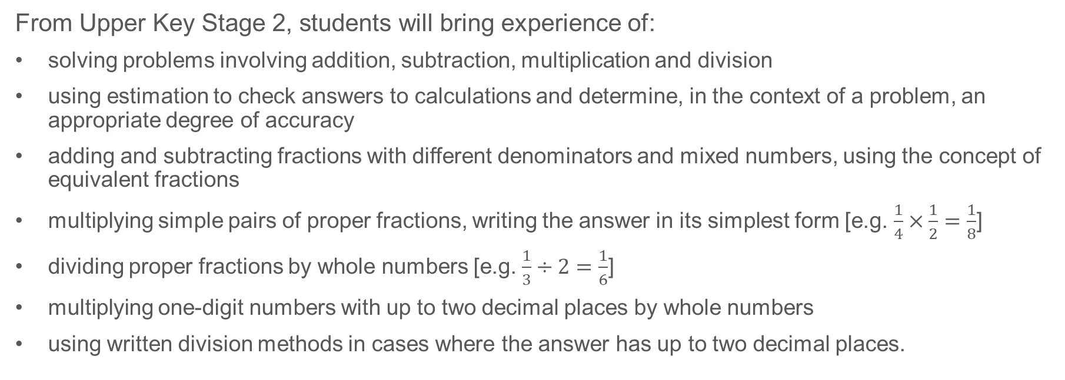
Previous learning (2)
From Upper Key Stage 2, students will bring experience of:
solving problems involving addition, subtraction, multiplication and division
using estimation to check answers to calculations and determine, in the context of a problem, an appropriate degree of accuracy
adding and subtracting fractions with different denominators and mixed numbers, using the concept of equivalent fractions
multiplying simple pairs of proper fractions, writing the answer in its simplest form [e.g. $\frac{1}{4}×\frac{1}{2}=\frac{1}{8}$]
dividing proper fractions by whole numbers [e.g. $\frac{1}{3}÷2=\frac{1}{6}$]
multiplying one-digit numbers with up to two decimal places by whole numbers
using written division methods in cases where the answer has up to two decimal places.
Notes:
Theme 2 Operating on number

Slide 34
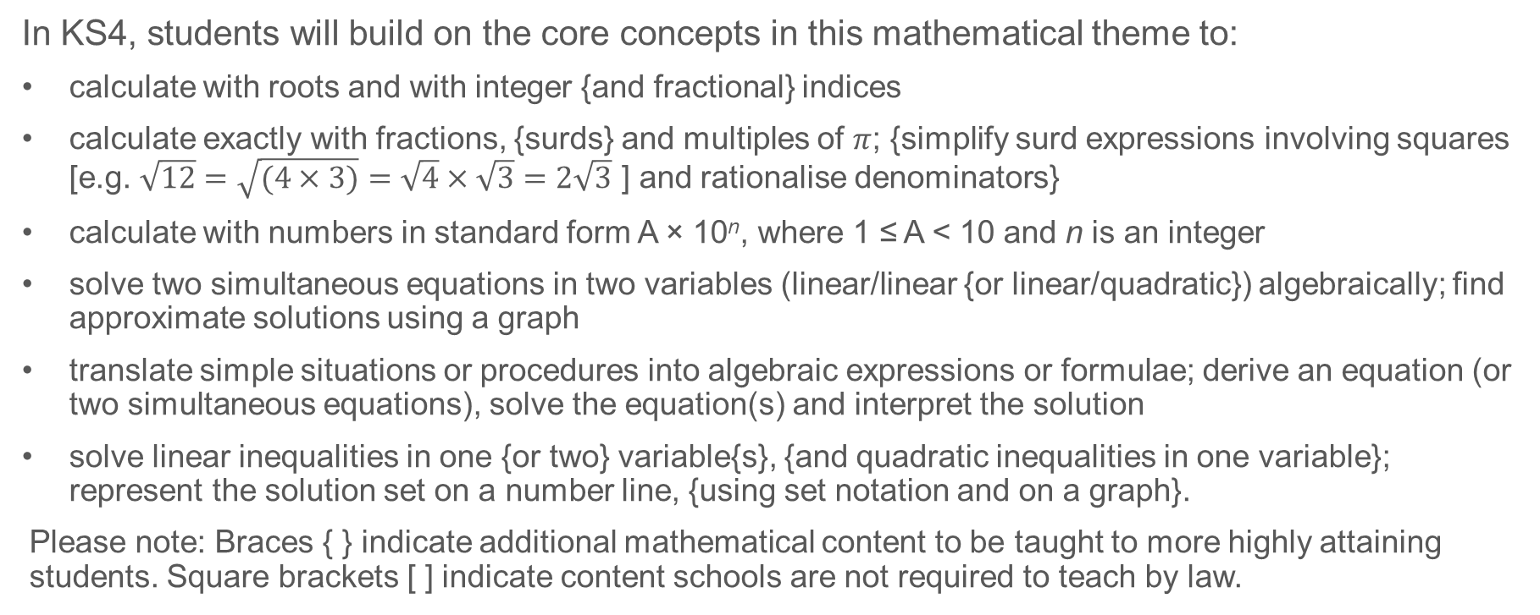
Future learning
In KS4, students will build on the core concepts in this mathematical theme to:
calculate with roots and with integer {and fractional} indices
calculate exactly with fractions, {surds} and multiples of $π$; {simplify surd expressions involving squares [e.g. $\sqrt{12}=\sqrt{(4×3)}=\sqrt{4}×\sqrt{3}=2\sqrt{3}$ ] and rationalise denominators}
calculate with numbers in standard form A × 10^{n}, where 1 ≤ A < 10 and n is an integer
solve two simultaneous equations in two variables (linear/linear {or linear/quadratic}) algebraically; find approximate solutions using a graph
translate simple situations or procedures into algebraic expressions or formulae; derive an equation (or two simultaneous equations), solve the equation(s) and interpret the solution
solve linear inequalities in one {or two} variable{s}, {and quadratic inequalities in one variable}; represent the solution set on a number line, {using set notation and on a graph}.
Please note: Braces { } indicate additional mathematical content to be taught to more highly attaining students. Square brackets [ ] indicate content schools are not required to teach by law.
Notes:
Theme 2 Operating on Number

Slide 35
Library of links
The following resources from the NCETM website have been referred to within this slide deck:
  NCETM Secondary Mastery Professional Development
    2 Operating on number Theme Overview Document
    2.1 Arithmetic procedures Core Concept Document
  Using mathematical representations at KS3 | NCETM
  Insights from experienced teachers | NCETM
  NCETM primary mastery professional development materials
  NCETM primary assessment materials
There are also references to:
  Standards & Testing Agency’s past mathematics papers

