Slide 1
2.4 Times tables: groups of 10 and 5, and factors of 0 and 1
Representations | Year 2
Multiplication and Division

Slide 2
How to use this presentation
You can find the teacher guide 2.4 Times tables: groups of 10 and 5, and factors of 0 and 1 by following the link below.

Slide 3
2.4 The 10 and 5 time tables Step 1:1
0
10
20
30
40
50
60
70
80
90
100
110
120

Slide 4
2.4 The 10 and 5 time tables Step 1:1

Slide 5
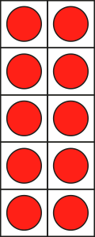
2.4 The 10 and 5 time tables Step 1:1
100
110
120
10
20
30
40
50
60
70
80
90
0
one hundred and twenty
one hundred and ten
one hundred
seventy
twenty
eighty
ninety
thirty
forty
sixty
zero
fifty
ten

Slide 6
2.4 The 10 and 5 time tables Step 1:1
100
110
120
10
20
30
40
50
60
70
80
90
0
one hundred and twenty
one hundred and ten
one hundred
seventy
twenty
eighty
ninety
thirty
forty
sixty
zero
fifty
ten

Slide 7
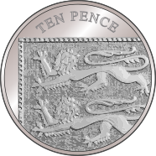
2.4 The 10 and 5 time tables Step 1:1
100
110
120
10
20
30
40
50
60
70
80
90
0
one hundred and twenty
one hundred and ten
one hundred
seventy
twenty
eighty
ninety
thirty
forty
sixty
zero
fifty
ten

Slide 8
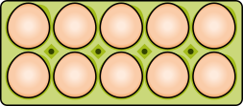
2.4 The 10 and 5 time tables Step 1:2
10
ten
20
twenty
30
thirty
3 × 10 = 30
Notes:
How many eggs are there? Count in groups of ten.

Slide 9
2.4 The 10 and 5 time tables Step 1:2
10
ten
20
twenty
30
thirty
40
forty
4 × 10 = 40
Notes:
Show me four groups of ten.
How many is this altogether?

Slide 10
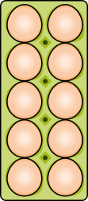
2.4 The 10 and 5 time tables Step 1:3
3 × 10 = 30
2 × 10 = 20
1 × 10 = 10
0 × 10 = 0

Slide 11
2.4 The 10 and 5 time tables Step 1:4
Number of children | 0
Number of fingers | 0
1
2
3
4
5
6
10
20
30
40
50
60
0 × 10 = 0
10 × 0 = 0
1 × 10 = 10
10 × 1 = 10
2 × 10 = 20
10 × 2 = 20
3 × 10 = 30
10 × 3 = 30
4 × 10 = 40
10 × 4 = 40
5 × 10 = 50
10 × 5 = 50
6 × 10 = 60
10 × 6 = 60

Slide 12
2.4 The 10 and 5 time tables Step 1:4
Number of children
Number of fingers
7
8
9
10
11
12
70
80
90
100
110
120
6 × 10 = 60
10 × 6 = 60
7 × 10 = 70
10 × 7 = 70
8 × 10 = 80
10 × 8 = 80
9 × 10 = 90
10 × 9 = 90
10 × 10 = 100
10 × 10 = 100
11 × 10 = 110
10 × 11 = 110
12 × 10 = 120
10 × 12 = 120

Slide 13
2.4 The 10 and 5 time tables Step 1:5
Number of children | Number of fingers
0 | 0
1 | 10
2 | 20
3 | 30
4 | 40
5 | 50
6 | 60
7 | 70
8 | 80
9 | 90
10 | 100
11 | 110
12 | 120
0 × 10 = 0 | 10 × 0 = 0
1 × 10 = 10 | 10 × 1 = 10
2 × 10 = 20 | 10 × 2 = 20
3 × 10 = 30 | 10 × 3 = 30
4 × 10 = 40 | 10 × 4 = 40
5 × 10 = 50 | 10 × 5 = 50
6 × 10 = 60 | 10 × 6 = 60
7 × 10 = 70 | 10 × 7 = 70
8 × 10 = 80 | 10 × 8 = 80
9 × 10 = 90 | 10 × 9 = 90
10 × 10 = 100 | 10 × 10 = 100
11 × 10 = 110 | 10 × 11 = 110
12 × 10 = 120 | 10 × 12 = 120

Slide 14
2.4 The 10 and 5 time tables Step 1:6

Slide 15
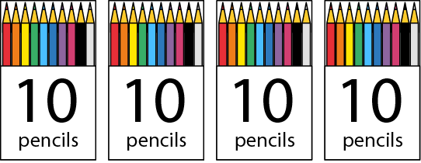
2.4 The 10 and 5 time tables Step 1:7
4 × 10 =
40
10 × 4 =
40
Notes:
Complete the equations to show how many pencils there are altogether.

Slide 16
2.4 The 10 and 5 time tables Step 1:7
5
× 10 =
50
10 ×
5
=
50
Notes:
Complete the equations to show how many pencils there are altogether.

Slide 17
2.4 The 10 and 5 time tables Step 1:7
6
×
10
=
60
10
×
6
=
60
Notes:
Complete the equations to show how many pencils there are altogether.

Slide 18
2.4 The 10 and 5 time tables Step 1:7
There are 10 birds on each wire.
Altogether there are 30 birds. How many wires are there?
3
× 10 = 30
Notes:
There are ten birds on each wire. Altogether there are 30 birds. How many wires are there?

Slide 19
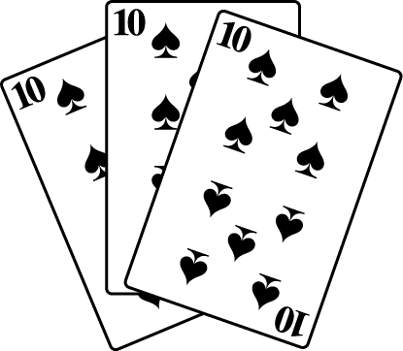
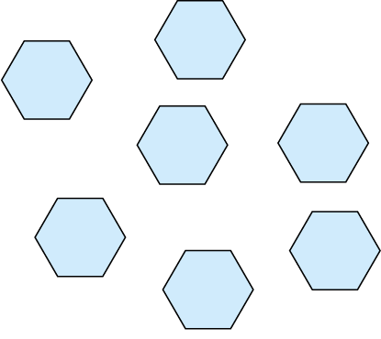
2.4 The 10 and 5 time tables Step 1:7
Facts in the 10 times table?
✓
✗
✗
4 + 10 = 40
✓
✓
✓
10 × 9 = 90
4 × 10 = 40
Notes:
Tick the examples that represent facts in the ten times table.

Slide 20
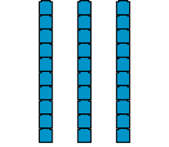
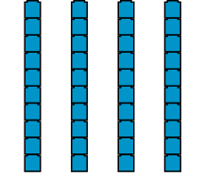
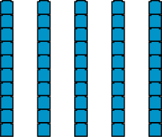
2.4 The 10 and 5 time tables Step 1:8
30 | 40 | 50
←
multiple of 10
→
10 less
10 more

Slide 21
2.4 The 10 and 5 time tables Step 1:8
 | × 10
0 | 0
1 | 10
2 | 20
3
4 | 40
5 | 50
6 | 60
7
8 | 80
9 | 90
10 | 100
11 | 110
12 | 120
 | × 10
2 | 20
3
70
↑ − 10
↓ + 10
3 × 10 = 2 × 10 + 10
7 × 10 = 8 × 10 − 10
30
 | × 10
7
8 | 80
+ 10
− 10
0
10
20
30
40
50
60
70
80
90
100

Slide 22
2.4 The 10 and 5 time tables Step 1:8
 |  | Factor
 | × | 1 | 2 | 3 | 4 | 5 | 6 | 7 | 8 | 9 | 10
Factor | 1
 | 2
 | 3
 | 4
 | 5
 |  | Factor
 | × | 1 | 2 | 3 | 4 | 5 | 6 | 7 | 8 | 9 | 10
Factor | 1
 | 2
 | 3
 | 4
 | 5
 | 6
6 × 10 = 5 × 10 +10
5 × 10 = 50
6 × 10 = 60

Slide 23
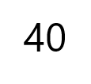
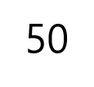
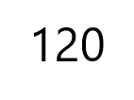
2.4 The 10 and 5 time tables Step 1:9
Notes:
Fill in the missing numbers.

Slide 24
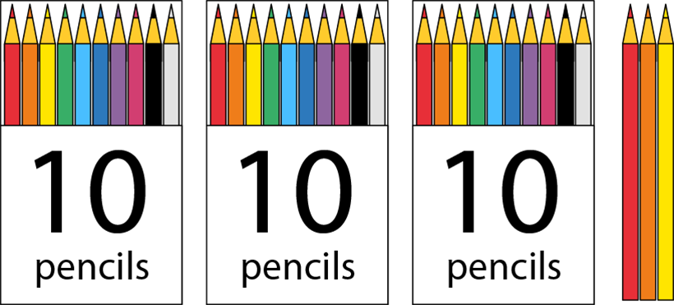
2.4 The 10 and 5 time tables Step 1:9
Which expression(s) match this picture?
4 × 10
✗
4 × 3
✗
10 × 3 + 3
✓
3 × 10 + 3
✓
Notes:
Which expression(s) match this picture? Explain why.

Slide 25
2.4 The 10 and 5 time tables Step 2:1
0
5
10
15
20
25
30
35
40
45
50
55
60

Slide 26
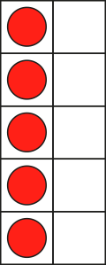
2.4 The 10 and 5 time tables Step 2:1
10
15
20
25
35
40
45
50
55
60
30
0
5
twenty-five
thirty-five
forty-five
fifty-five
twenty
fifteen
thirty
forty
sixty
zero
fifty
five
ten

Slide 27
2.4 The 10 and 5 time tables Step 2:1
10
15
20
25
35
40
45
50
55
60
30
0
5
twenty-five
thirty-five
forty-five
fifty-five
twenty
fifteen
thirty
forty
sixty
zero
fifty
five
ten

Slide 28
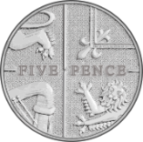
2.4 The 10 and 5 time tables Step 2:1
10
15
20
25
35
40
45
50
55
60
30
0
5
twenty-five
thirty-five
forty-five
fifty-five
twenty
fifteen
thirty
forty
sixty
zero
fifty
five
ten

Slide 29
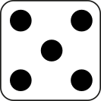
2.4 The 10 and 5 time tables Step 2:2
5
five
10
ten
15
fifteen
3 × 5 = 15
Notes:
How many dots are there? Count in groups of five.

Slide 30
2.4 The 10 and 5 time tables Step 2:2
5
five
10
ten
15
fifteen
20
twenty
25
twenty-five
30
thirty
6 × 5 = 30
Notes:
Show me six groups of five. How many is this altogether? Count in groups of five.

Slide 31
2.4 The 10 and 5 time tables Step 2:3
3 × 5 = 15
2 × 5 = 10
1 × 5 = 5
0 × 5 = 0

Slide 32
2.4 The 10 and 5 time tables Step 2:4
Number of hands | 0
Number of fingers | 0
1
2
3
4
5
6
5
10
15
20
25
30
0 × 5 = 0
5 × 0 = 0
1 × 5 = 5
5 × 1 = 5
2 × 5 = 10
5 × 2 = 10
3 × 5 = 15
5 × 3 = 15
4 × 5 = 20
5 × 4 = 20
5 × 5 = 25
5 × 5 = 25
6 × 5 = 30
5 × 6 = 30

Slide 33
2.4 The 10 and 5 time tables Step 2:4
Number of hands
Number of fingers
7
8
9
10
11
12
35
40
45
50
55
60
6 × 5 = 30
5 × 6 = 30
7 × 5 = 35
5 × 7 = 35
8 × 5 = 40
5 × 8 = 40
9 × 5 = 45
5 × 9 = 45
10 × 5 = 50
5 × 10 = 50
11 × 5 = 55
5 × 11 = 55
12 × 5 = 60
5 × 12 = 60

Slide 34
2.4 The 10 and 5 time tables Step 2:5
Number of hands | Number of fingers
0 | 0
1 | 5
2 | 10
3 | 15
4 | 20
5 | 25
6 | 30
7 | 35
8 | 40
9 | 45
10 | 50
11 | 55
12 | 60
0 × 5 = 0 | 5 × 0 = 0
1 × 5 = 5 | 5 × 1 = 5
2 × 5 = 10 | 5 × 2 = 10
3 × 5 = 15 | 5 × 3 = 15
4 × 5 = 20 | 5 × 4 = 20
5 × 5 = 25 | 5 × 5 = 25
6 × 5 = 30 | 5 × 6 = 30
7 × 5 = 35 | 5 × 7 = 35
8 × 5 = 40 | 5 × 8 = 40
9 × 5 = 45 | 5 × 9 = 45
10 × 5 = 50 | 5 × 10 = 50
11 × 5 = 55 | 5 × 11 = 55
12 × 5 = 60 | 5 × 12 = 60

Slide 35
2.4 The 10 and 5 time tables Step 2:6

Slide 36
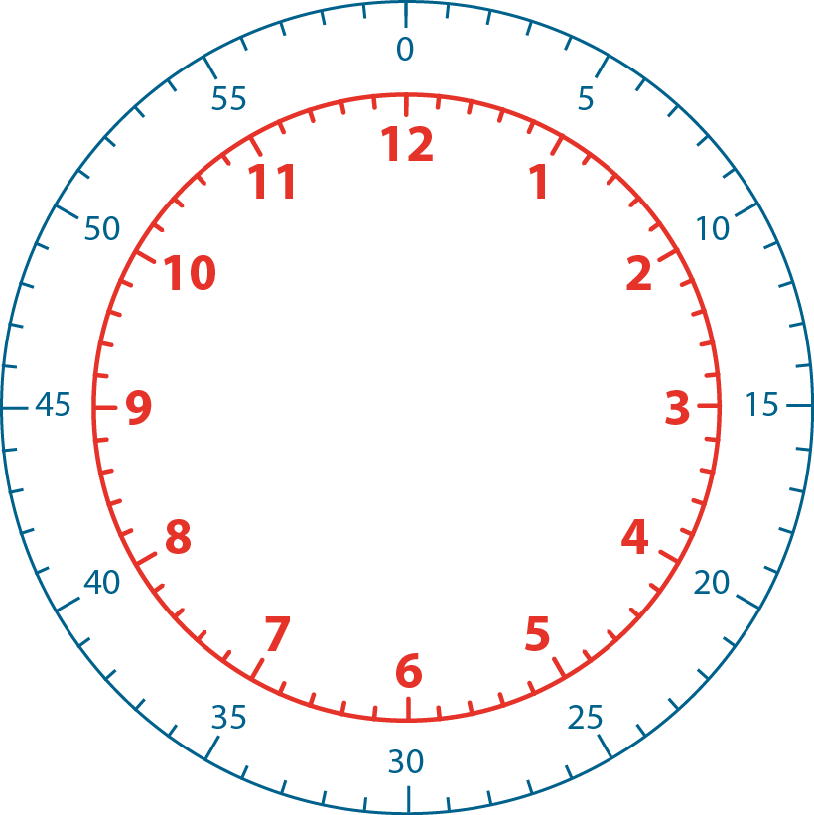
2.4 The 10 and 5 time tables Step 2:6
Notes:
If the minute hand is pointing at “3”, how many minutes past the hour is it?

Slide 37
2.4 The 10 and 5 time tables Step 2:6
Notes:
If the minute hand is pointing at “4”, how many minutes past the hour is it?

Slide 38
2.4 The 10 and 5 time tables Step 2:6
Notes:
What about if the minute hand is pointing at “2”?

Slide 39
2.4 The 10 and 5 time tables Step 2:6
Notes:
What about if the minute hand is pointing at “5”?

Slide 40
2.4 The 10 and 5 time tables Step 2:6
Notes:
If the minute hand is pointing at “10”, how many minutes before the hour is it?

Slide 41
2.4 The 10 and 5 time tables Step 2:7
1 × 5 = 5
5 × 1 = 5

Slide 42
2.4 The 10 and 5 time tables Step 2:7
Facts in the 5 times table?
✓
✗
✗
9 + 5 = 45
✓
✓
✓
5 × 9 = 45
9 × 5 = 45
Notes:
Tick the examples that represent facts in the five times table.

Slide 43
2.4 The 10 and 5 time tables Step 2:8
 | × 5
0 | 0
1 | 5
2 | 10
3
4 | 20
5 | 25
6 | 30
7
8 | 40
9 | 45
10 | 50
11 | 55
12 | 60
 | × 5
2 | 10
3
35
↑ − 5
↓ + 5
3 × 5 = 2 × 5 + 5
7 × 5 = 8 × 5 − 5
15
 | × 5
7
8 | 40
+ 5
− 5
0
5
10
15
20
25
30
35
40
45
50

Slide 44
2.4 The 10 and 5 time tables Step 2:8
 |  | Factor
 | × | 1 | 2 | 3 | 4 | 5
Factor | 1
 | 2
 | 3
 | 4
 | 5
 |  | Factor
 | × | 1 | 2 | 3 | 4 | 5
Factor | 1
 | 2
 | 3
 | 4
 | 5
 | 6
5 × 5 = 25
6 × 5 = 5 × 5 + 5
6 × 5 = 30

Slide 45
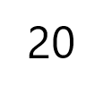
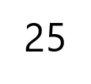
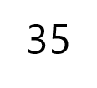
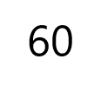
2.4 The 10 and 5 time tables Step 2:9

Slide 46
2.4 The 10 and 5 time tables Step 3:1
0
5
10
15
20
25
30
35
40
45
50
55
60

Slide 47
2.4 The 10 and 5 time tables Step 3:1

Slide 48
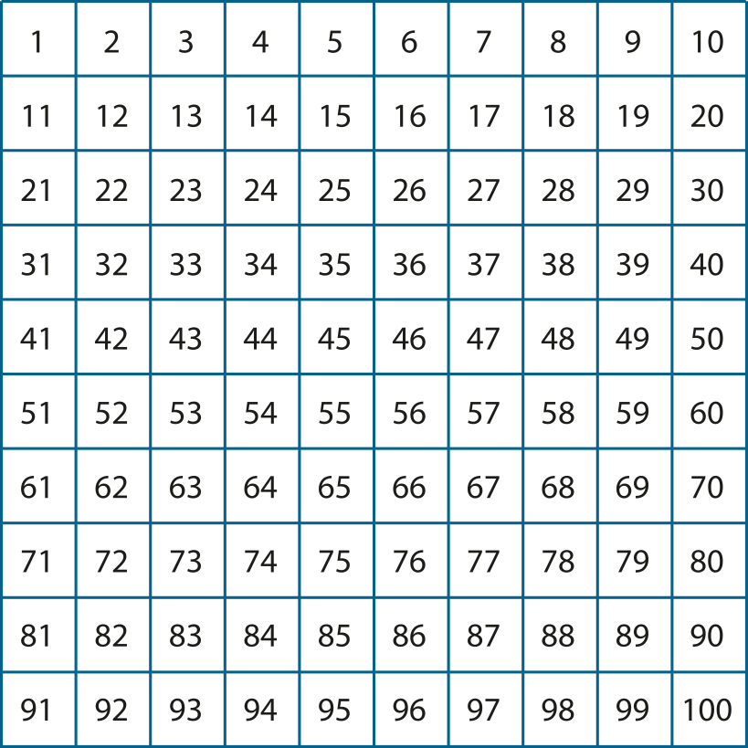
2.4 The 10 and 5 time tables Step 3:1

Slide 49
2.4 The 10 and 5 time tables Step 3:1
Number | 0 | 1 | 2 | 3 | 4 | 5 | 6 | 7 | 8 | 9 | 10 | 11 | 12 | 13 | 14 | 15 | 16 | 17 | 18 | 19 | 20 | 21 | 22 | 23 | 24 | 25
Counting in 5s
Counting in 10s
✓
✓
✓
✓
✓
✓
✓
✓
✓

Slide 50
2.4 The 10 and 5 time tables Step 3:2
Notes:
How many groups of five are there?
How many groups of ten are there?

Slide 51
2.4 The 10 and 5 time tables Step 3:3
10 cm
10 cm
10 cm
5 cm
5 cm
5 cm
5 cm
5 cm
5 cm
Notes:
There are three ten centimetre lengths of ribbon.
How many five centimetre lengths can be made?

Slide 52
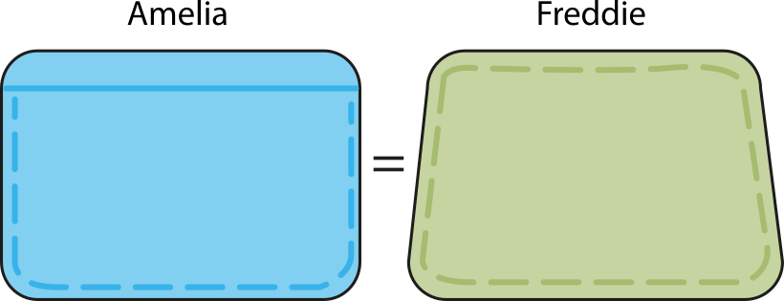
2.4 The 10 and 5 time tables Step 3:3
4 × 5 p
2
× 10 p
Notes:
Amelia has four five-pence coins.
Freddie has the same amount of money, in ten-pence coins.
How many ten-pence coins does Freddie have?

Slide 53
2.4 The 10 and 5 time tables Step 3:4
6 × 5 = 30
3 × 10 = 30

Slide 54
2.4 The 10 and 5 time tables Step 3:4
0 × 5 = 0 | 0 × 10 = 0
1 × 5 = 5 | 1 × 10 = 10
2 × 5 = 10 | 2 × 10 = 20
3 × 5 = 15 | 3 × 10 = 30
4 × 5 = 20 | 4 × 10 = 40
5 × 5 = 25 | 5 × 10 = 50
6 × 5 = 30 | 6 × 10 = 60
7 × 5 = 35 | 7 × 10 = 70
8 × 5 = 40 | 8 × 10 = 80
9 × 5 = 45 | 9 × 10 = 90
10 × 5 = 50 | 10 × 10 = 100
11 × 5 = 55 | 11 × 10 = 110
12 × 5 = 60 | 12 × 10 = 120

Slide 55
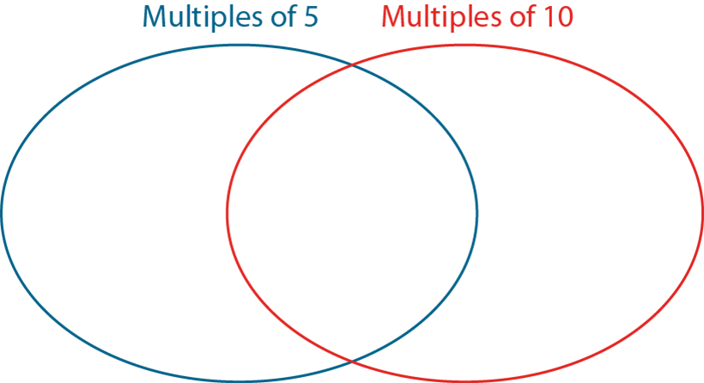
2.4 The 10 and 5 time tables Step 3:5
0
5
10
27
35
31
40
15
100

Slide 56
2.4 The 10 and 5 time tables Step 3:6
0 | × 5 = | 0 | = 10 × | 0
2 |  | 10 |  | 1
4 |  |  |  | 2
6 |  |  |  | 3
8 |  |  |  | 4
10 |  |  |  | 5
12 |  |  |  | 6
20
30
40
50
60

Slide 57
2.4 The 10 and 5 time tables Step 4:1
2 times table |  | 5 times table |  | 10 times table
0 × 2 = 0 | 2 × 0 = 0 | 0 × 5 = 0 | 5 × 0 = 0 | 0 × 10 = 0 | 0 × 10 = 0
1 × 2 = 2 | 2 × 1 = 2 | 1 × 5 = 5 | 5 × 1 = 5 | 1 × 10 = 10 | 1 × 10 = 10
2 × 2 = 4 | 2 × 2 = 4 | 2 × 5 = 10 | 5 × 2 = 10 | 2 × 10 = 20 | 2 × 10 = 20

Slide 58
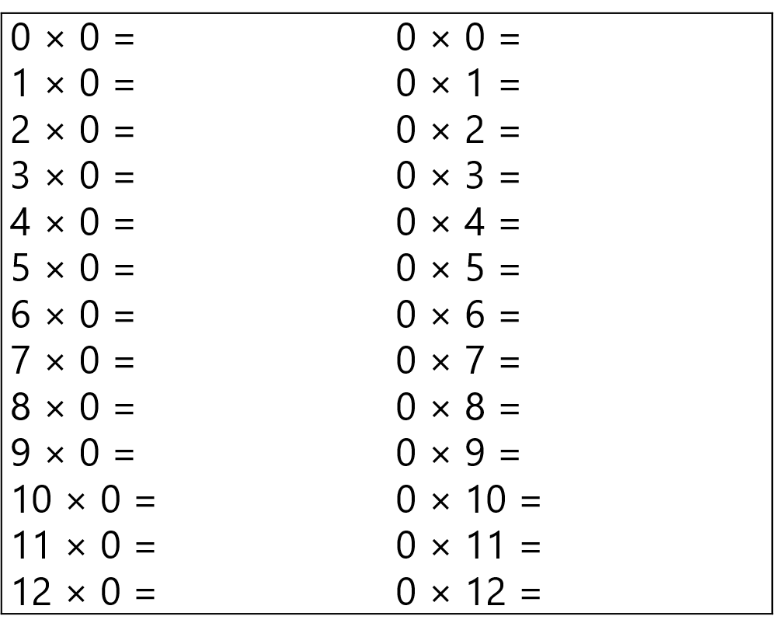
2.4 The 10 and 5 time tables Step 4:2

Slide 59
2.4 The 10 and 5 time tables Step 4:4
2 times table |  | 5 times table |  | 10 times table
0 × 2 = 0 | 2 × 0 = 0 | 0 × 5 = 0 | 5 × 0 = 0 | 0 × 10 = 0 | 0 × 10 = 0
1 × 2 = 2 | 2 × 1 = 2 | 1 × 5 = 5 | 5 × 1 = 5 | 1 × 10 = 10 | 1 × 10 = 10
2 × 2 = 4 | 2 × 2 = 4 | 2 × 5 = 10 | 5 × 2 = 10 | 2 × 10 = 20 | 2 × 10 = 20

Slide 60
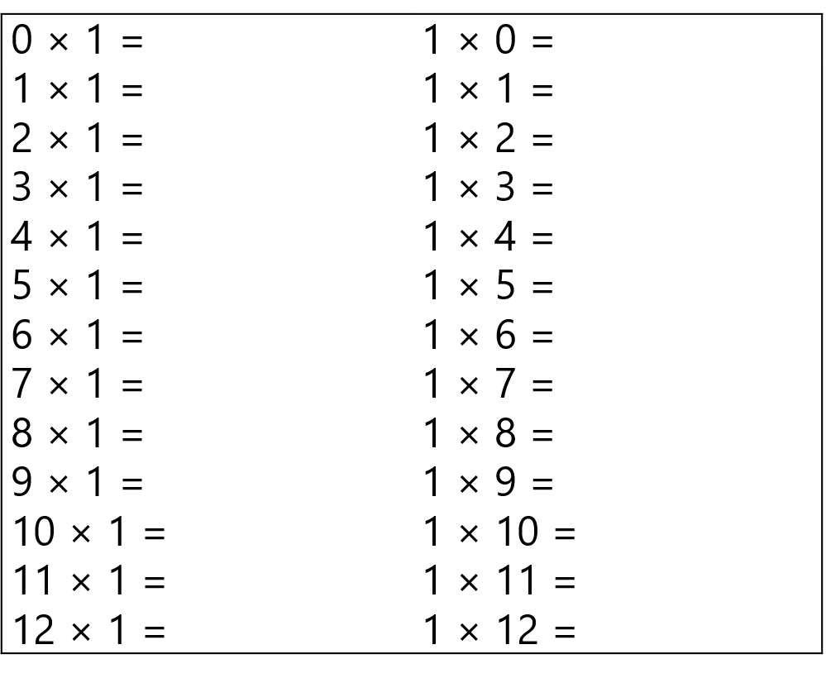
2.4 The 10 and 5 time tables Step 4:5

Slide 61
2.4 The 10 and 5 time tables Step 4:6
 | factor | factor | product
factor |  |  | 0
factor |  |  | 5
product | 0 | 10
0
10
5
1
Notes:
Fill in the missing numbers.

