Slide 1
1.12 Subtraction as difference
Representations | Year 2
Number, Addition and Subtraction

Slide 2
How to use this presentation
You can find the teacher guide 1.12 Subtraction as difference by following the link below.

Slide 3
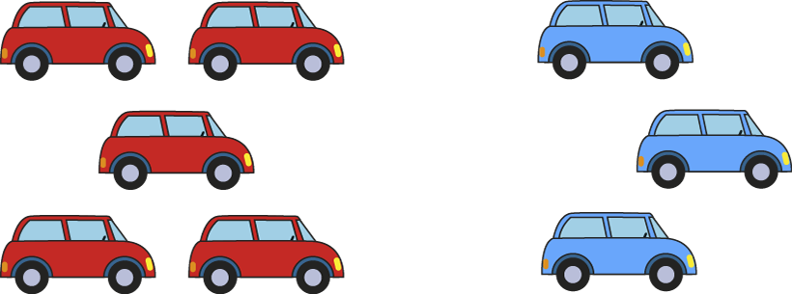
1.12 Subtraction as difference – step 1:1

Slide 4
1.12 Subtraction as difference – step 1:1

Slide 5
1.12 Subtraction as difference – step 1:2
2 cars

Slide 6
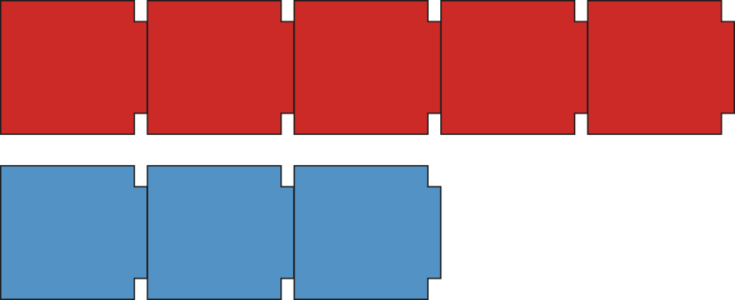
1.12 Subtraction as difference – step 1:2
2 cars
2 cars

Slide 7
1.12 Subtraction as difference – step 1:2
5 red cars
3 blue cars
2 cars

Slide 8
1.12 Subtraction as difference – step 1:3
difference of 3

Slide 9
1.12 Subtraction as difference – step 1:3
difference of 4

Slide 10
1.12 Subtraction as difference – step 1:3
Ben is ten years old
Charlotte is three years old
10 years old
3 years old
difference of 7 years

Slide 11
1.12 Subtraction as difference – step 1:4
7
4
3

Slide 12
1.12 Subtraction as difference – step 1:4
3

Slide 13
1.12 Subtraction as difference – step 2:1
Notes:
There are eight children and only three pencils. How many more pencils does the teacher need so each child has one pencil?

Slide 14
1.12 Subtraction as difference – step 2:1
8
3
5
8 – 3 = 5

Slide 15
1.12 Subtraction as difference – step 2:1
8
3
5
5
8 – 3 = 5

Slide 16
1.12 Subtraction as difference – step 2:2

Slide 17
1.12 Subtraction as difference – step 2:3
3 =
4 – 1
5 – 2
6 – 3
7 – 4

Slide 18
1.12 Subtraction as difference – step 2:5
5 – 3 = 2
Notes:
Five children are playing in the playground. Three are playing on the swings; the rest are playing on the roundabout. How many are playing on the roundabout?
(partitioning)

Slide 19
1.12 Subtraction as difference – step 2:5
5 – 3 = 2
Notes:
At first there were five swans on a lake, then three flew away. How many swans are on the lake now?
(reduction)

Slide 20
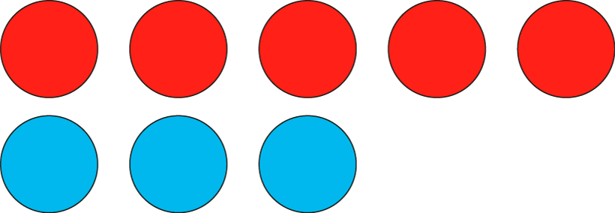
1.12 Subtraction as difference – step 2:5
2
5 – 3 = 2
Notes:
There are five ducks on the pond and three ducks on the lake. How many more ducks are on the pond?
(difference)

Slide 21
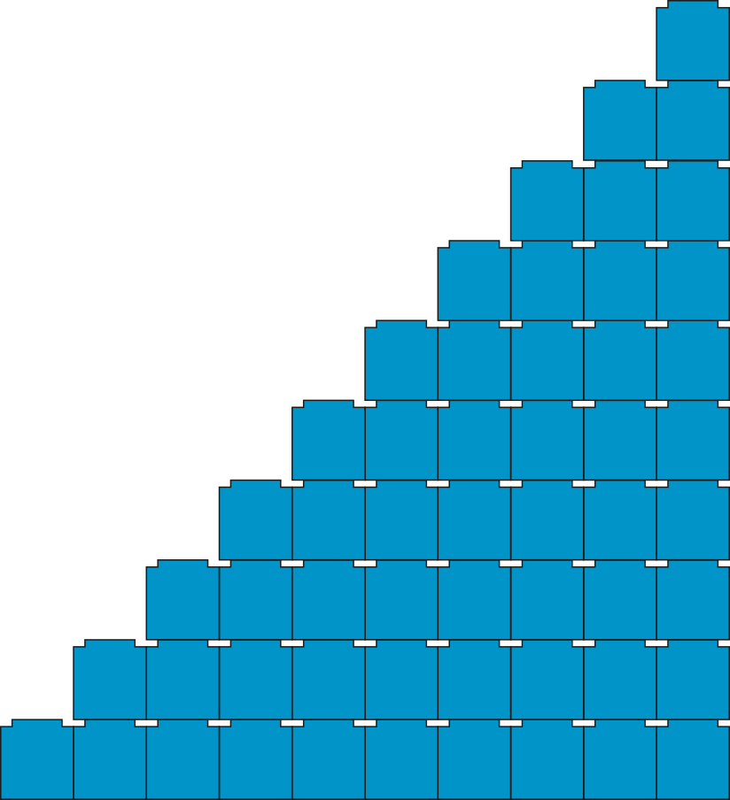
1.12 Subtraction as difference – step 3:1

Slide 22
1.12 Subtraction as difference – step 3:1
 | 0 | 1 | 2 | 3 | 4 | 5 | 6 | 7 | 8 | 9 | 10
1 | 1 − 0 | 1 − 1
2 | 2 − 0 | 2 − 1 | 2 – 2
3 | 3 − 0 | 3 − 1 | 3 – 2 | 3 – 3
4 | 4 − 0 | 4 − 1 | 4 − 2 | 4 − 3 | 4 − 4
5 | 5 − 0 | 5 − 1 | 5 − 2 | 5 − 3 | 5 − 4 | 5 − 5
6 | 6 − 0 | 6 − 1 | 6 − 2 | 6 − 3 | 6 − 4 | 6 − 5 | 6 − 6
7 | 7 − 0 | 7 − 1 | 7 − 2 | 7 − 3 | 7 − 4 | 7 − 5 | 7 − 6 | 7 − 7
8 | 8 − 0 | 8 − 1 | 8 − 2 | 8 − 3 | 8 − 4 | 8 − 5 | 8 − 6 | 8 − 7 | 8 − 8
9 | 9 − 0 | 9 − 1 | 9 − 2 | 9 − 3 | 9 − 4 | 9 − 5 | 9 − 6 | 9 − 7 | 9 − 8 | 9 − 9
10 | 10 − 0 | 10 − 1 | 10 − 2 | 10 − 3 | 10 − 4 | 10 − 5 | 10 − 6 | 10 − 7 | 10 − 8 | 10 − 9 | 10 − 10

Slide 23
1.12 Subtraction as difference – step 3:3

Slide 24
1.12 Subtraction as difference – step 3:3

Slide 25
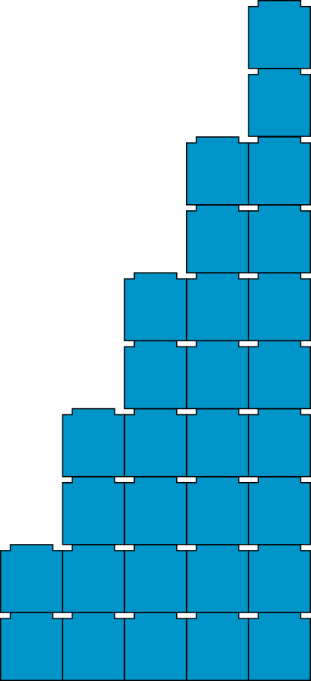
1.12 Subtraction as difference – step 3:4

Slide 26
1.12 Subtraction as difference – step 3:4

Slide 27
1.12 Subtraction as difference – step 4:1
15
12
3
12 + 3 = 15
3
15 – 12 = 15
3

Slide 28
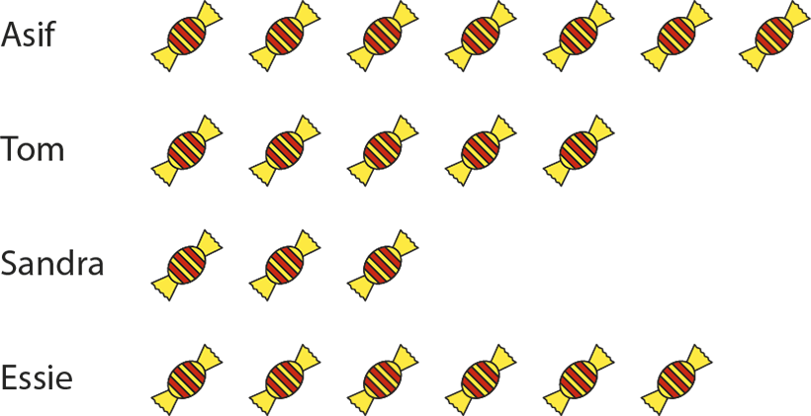
1.12 Subtraction as difference – step 4:2
Notes:
How many more sweets does Asif have than Sandra?
How many fewer sweets does Tom have than Essie?
What is the difference between the number of sweets that Essie has and the number that Sandra has?

Slide 29
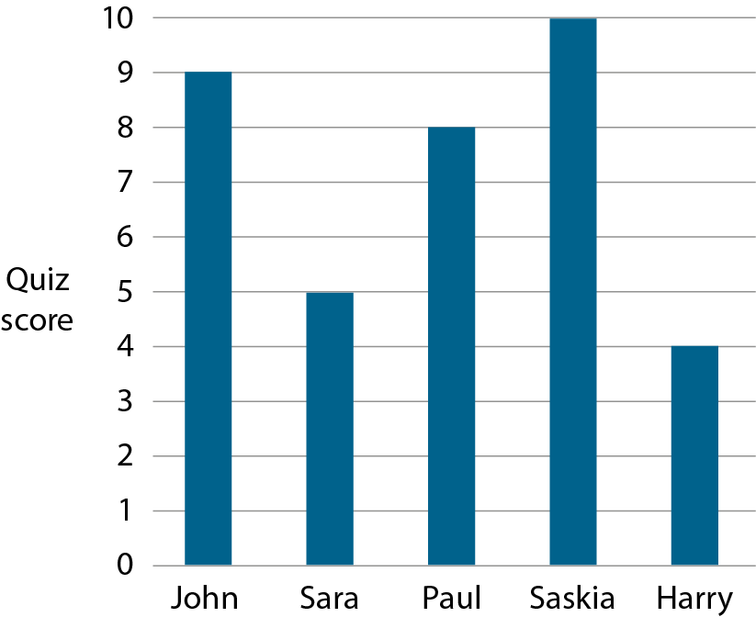
1.12 Subtraction as difference – step 4:3
Notes:
How much more did John score than Sara?
How much less did Harry score than Saskia?
What is the difference between Saskia’s score and Paul’s score?

Slide 30
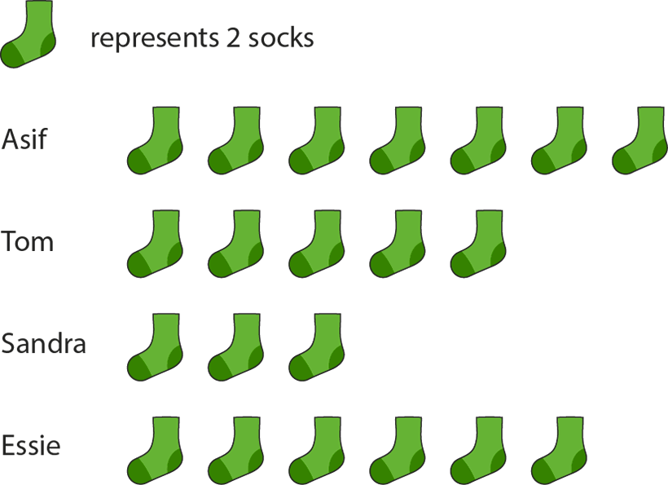
1.12 Subtraction as difference – step 4:4
Notes:
How many more socks does Asif have than Sandra?
How many fewer socks does Tom have than Essie?
What is the difference between the number of socks that Essie has and the number that Sandra has?

