Slide 1
1.19 Securing mental strategies: calculation up to 999
Representations | Year 3
Number, Addition and Subtraction

Slide 2
How to use this presentation
You can find the teacher guide 1.19 Securing mental strategies: calculation up to 999 by following the link below.

Slide 3
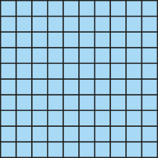
1.19 Securing mental strategies – step 1:1
87 + 56
= 130 + 13
= 143
80
7
50
6
130
13

Slide 4
1.19 Securing mental strategies – step 1:3
111
?
67
44

Slide 5
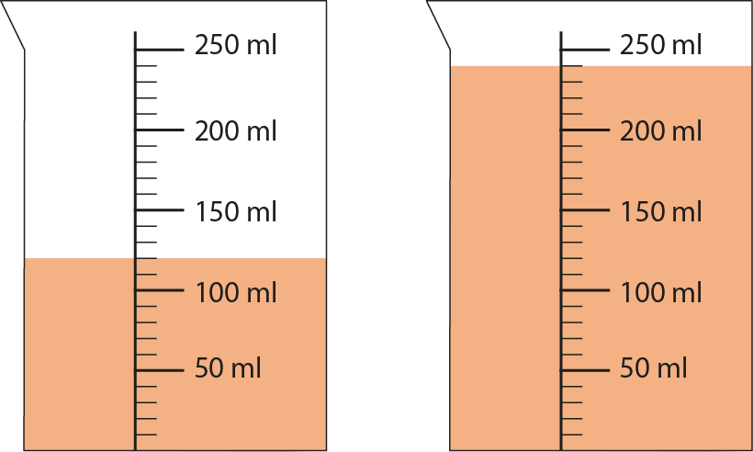
1.19 Securing mental strategies – step 1:3
120 ml
+
240 ml
= 360 ml

Slide 6
1.19 Securing mental strategies – step 2:1
35 + 49
= 30 + 40 + 5 + 9
= 70 + 14
= 84
Method A

Slide 7
1.19 Securing mental strategies – step 2:1
35 + 49
= 84
+ 50
− 1
35
84
85
+ 49
Method B

Slide 8
1.19 Securing mental strategies – step 2:1
35 + 49
= 34 + 50
= 84
Method C

Slide 9
1.19 Securing mental strategies – step 2:1
35 + 49
= 34 + 50
= 84
34
1
Method C

Slide 10
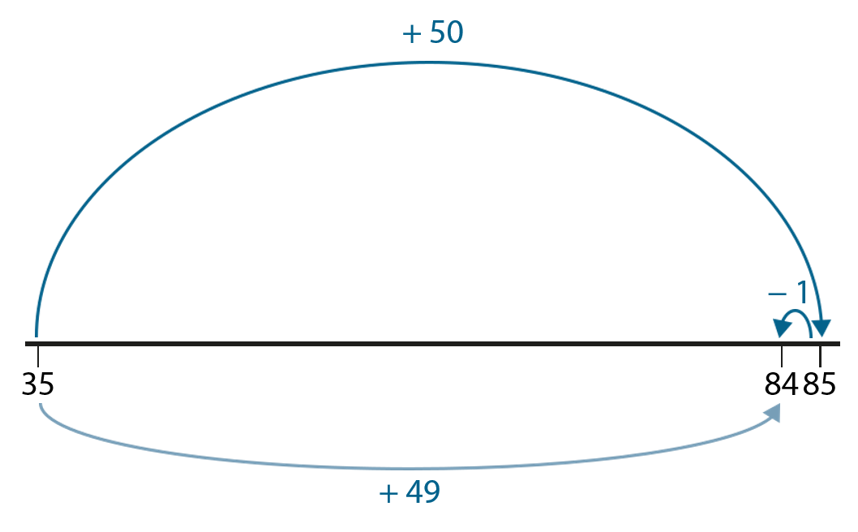
1.19 Securing mental strategies – step 2:1
Method A
Method B
35 + 49
= 30 + 40 + 5 + 9
= 70 + 14
= 84
Method C

Slide 11
1.19 Securing mental strategies – step 2:2
52 + 29
= 81
+ 30
− 1
52
81
82
+ 29

Slide 12
1.19 Securing mental strategies – step 2:4
520 + 290
= 810
+ 300
− 10
520
810
820
+ 290

Slide 13
1.19 Securing mental strategies – step 2:4
520 + 299
= 819
+ 300
− 1
520
819
820
+ 299

Slide 14
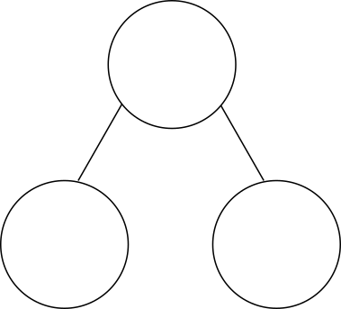
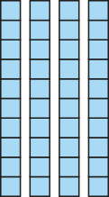
1.19 Securing mental strategies – step 2:6
45 + 29
= 44 + 30
= 74
74

Slide 15
1.19 Securing mental strategies – step 2:9
27 + 18
= 25 + 20
= 45
25
2
45

Slide 16
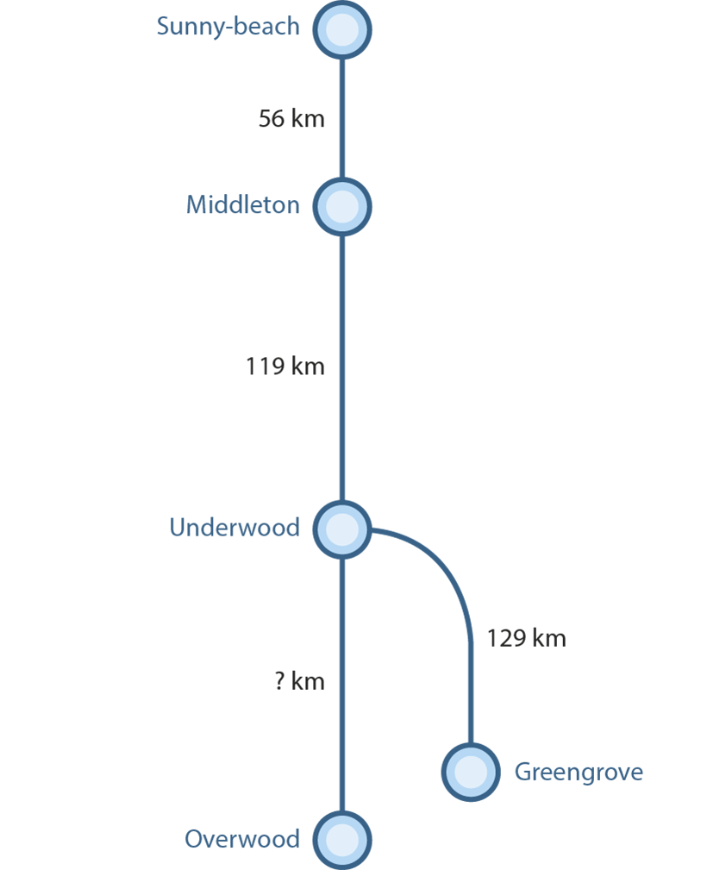
1.19 Securing mental strategies – step 2:12
Notes:
‘How far is it from Sunny-beach to Underwood?’
‘How far is it from Middleton to Greengrove?’
‘The journey from Underwood to Overwood is 44 km longer than from Underwood to Greengrove. How far is it from Underwood to Overwood?’

Slide 17
1.19 Securing mental strategies – step 3:1
78 − 24
= 54
− 4
− 20
54
58
78

Slide 18
1.19 Securing mental strategies – step 3:1
178 − 24
= 154
− 4
− 20
154
158
178

Slide 19
1.19 Securing mental strategies – step 3:1
780 − 240
= 540
− 40
− 200
540
580
780

Slide 20
1.19 Securing mental strategies – step 3:2
44 − 16
= 28
− 2
− 4
− 10
28
30
34
44

Slide 21
1.19 Securing mental strategies – step 3:2
544 − 16
= 528
− 2
− 4
− 10
528
530
534
544

Slide 22
1.19 Securing mental strategies – step 3:2
440 − 160
= 280
− 20
− 40
− 100
280
300
340
440

Slide 23
1.19 Securing mental strategies – step 3:3
43 − 39
= 4
+ 1
+ 3
0
39
40
43

Slide 24
1.19 Securing mental strategies – step 3:4
43
39
?
4

Slide 25
1.19 Securing mental strategies – step 3:5
61 − 49
= 12
+ 1
+ 11
0
49
50
61

Slide 26
1.19 Securing mental strategies – step 3:5
61
49
?
12

Slide 27
1.19 Securing mental strategies – step 3:5
123 − 97
= 26
+ 3
+ 23
97
100
123

Slide 28
1.19 Securing mental strategies – step 3:5
123
97
?
26

Slide 29
1.19 Securing mental strategies – step 3:6
761
749
?

Slide 30
1.19 Securing mental strategies – step 3:6
61 − 49
= 12
+ 1
+ 11
49
50
61
761 − 749
= 12
+ 1
+ 11
749
750
761

Slide 31
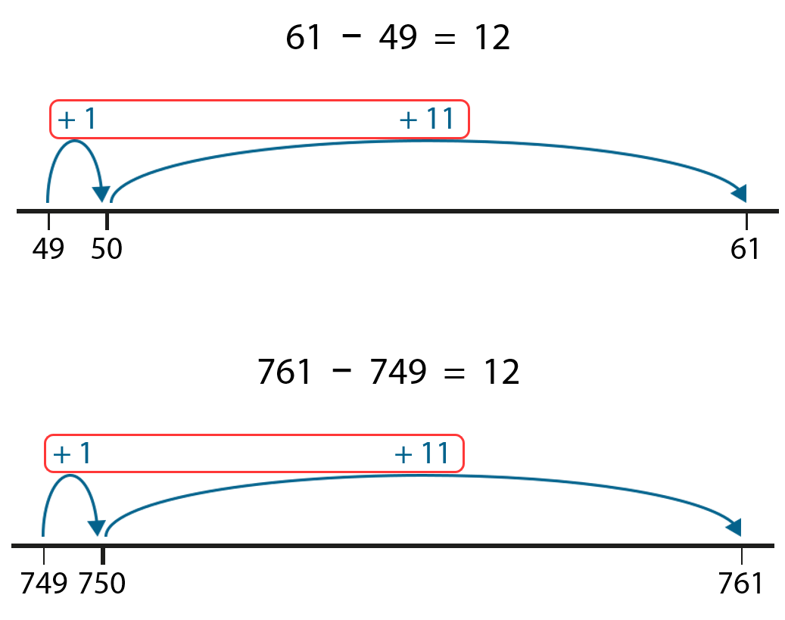
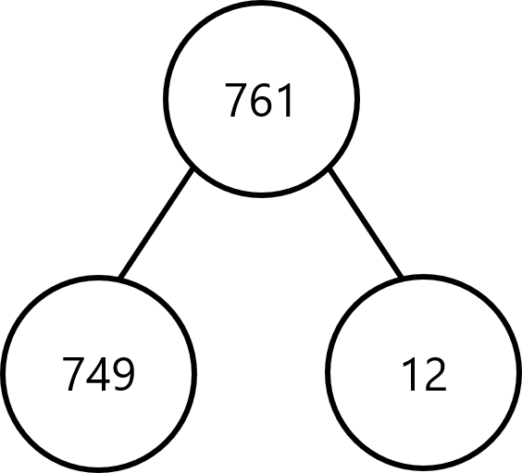
1.19 Securing mental strategies – step 3:6
761
749
12
?

Slide 32
1.19 Securing mental strategies – step 3:6
523
497
?

Slide 33
1.19 Securing mental strategies – step 3:6
123 − 97
= 26
+ 3
+ 23
97
100
123
523 − 497
= 26
+ 3
+ 23
497
500
523

Slide 34
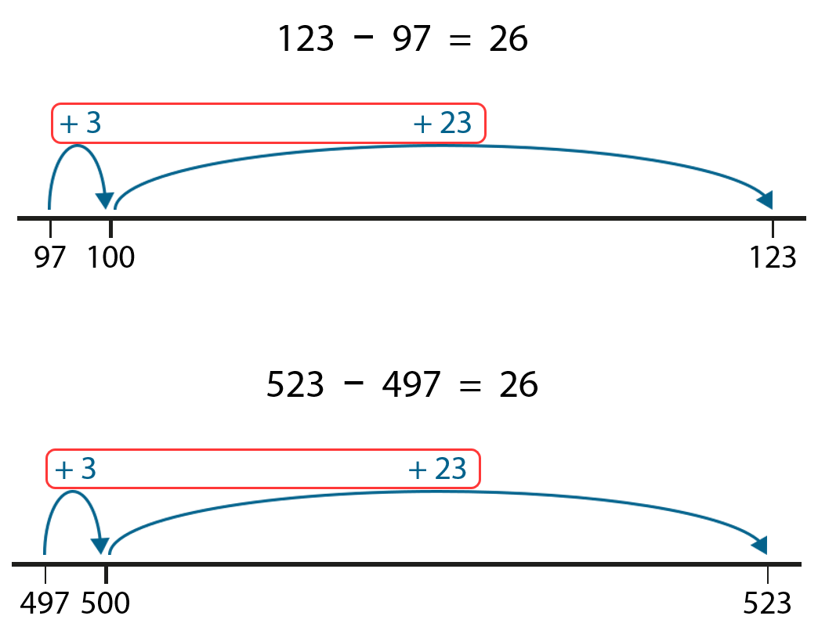
1.19 Securing mental strategies – step 3:6
523
26
497
?

Slide 35
1.19 Securing mental strategies – step 3:7
610 − 590
= 20
610
590
20
?
+ 10
+ 10
590
600
610

Slide 36
1.19 Securing mental strategies – step 3:7
610 − 490
= 120
610
490
?
120
+ 10
+ 100
+ 10
490
500
600
610

Slide 37
1.19 Securing mental strategies – step 3:9
132 − 14
− 4
− 10
118
122
132

Slide 38
1.19 Securing mental strategies – step 3:9
132 − 14
= 118
− 4
− 10
118
122
132
+ 6
+ 80
+ 32
14
20
100
132

Slide 39
1.19 Securing mental strategies – step 3:9
132 − 125
− 5
− 20
− 100
7
12
32
132

Slide 40
1.19 Securing mental strategies – step 3:9
132 − 125
= 7
− 5
− 20
− 100
7
12
32
132
+ 5
+ 2
125
130
132

Slide 41
1.19 Securing mental strategies – step 3:10
87
57
?
33
59
24
?
28

