Slide 1
Multiplying expressions by terms
KS3 Mastery PD Materials: Exemplified Key Ideas
Materials for use in the classroom or to support professional development discussions
(From 1.4 Simplifying and manipulating expressions, equations and formulae)
Summer 2021

Slide 2
About this resource
These slides are designed to complement the 1.4 Simplifying and manipulating expressions, equations and formulae Core Concept document and its associated Theme Overview document 1 The Structure of the number system, both found in the Secondary Mastery Professional Development pages.
These slides re-present the key examples from the Core Concept document so that the examples can be used either directly in the classroom or with a group of teachers. There are prompt questions alongside the examples, and further clarification in the notes.
These slides do not fully replicate the Core Concept document, so should be used alongside it. Reference to specific page numbers, and to other useful NCETM resources, can be found in the notes for each slide.
This slide deck is not designed to be a complete PD session, rather it is a selection of resources that you can adapt and use as needed when planning a session with a group of teachers.

Slide 3


About this resource
The slides are structured as follows:
  The big picture:
    Where does this fit in?
    What do students need to understand?
    Why is this key idea important?
  Prior learning
  Misconceptions
  Exemplified key ideas
  Reflection questions
  Appendices:
    Key vocabulary
    Representations and structure
    Previous and Future learning
    Useful links
The exemplified key idea slides have the following symbols to indicate how they have been designed to be used:
Into the classroom
The examples are presented on these slides so that they could be used in PD, but also directly in the classroom. The notes feature suggested questions and things teachers might consider when using with students.
PD discussion prompts
These slides look at the examples in more detail, with question prompts to promote discussion among maths teachers. The notes feature reference to further information and guidance within the Core Concepts document.

Slide 4
Where does this fit in?
The NCETM has identified a set of six ‘mathematical themes’ within Key Stage 3 mathematics that bring together a group of ‘core concepts’.
The first of these themes is The structure of the number system, which covers the following interconnected core concepts:
    1.1 Place value, estimation and rounding
    1.2 Properties of number
    1.3 Ordering and comparing
    1.4 Simplifying and manipulating expressions, equations and formulae
Notes:
Linked on this slide is the Theme Overview document of The structure of the number system. This document includes why it is important, the key underpinning knowledge and links to prior and future learning. There is also guidance about how the five big ideas of Teaching for Mastery relate specifically to this theme.

Slide 5
Where does this fit in?
Within this core concept, 1.4 Simplifying and manipulating expressions, equations and formulae, there are three statements of knowledge, skills and understanding.
These, in turn, are broken down into seventeen key ideas. The highlighted key idea is exemplified in this slide deck.
Notes:
For key ideas marked with an asterisk, we exemplified the common difficulties and misconceptions that students might have and included elements of what teaching for mastery may look like. We have provided examples of possible student tasks and teaching approaches.
Within these slides are ‘classroom-ready’ versions of the examples for the key idea that has been highlighted. There are also slides that may be useful for discussion in a professional development session.

Slide 6
What do students need to understand?
1.4.3.1 Understand how to use the distributive law to multiply an expression by a term such as 3(a + 4b) and 3p²(2p + 3b)
Understand the structure of the distributive law.
Understand the impact of the multiplier.
Understand that the multiplier can be a variable.
Understand the importance of the sign (positive or negative) of each term in an expression and how it affects the final result.
Understand the impact of a negative multiplier on the result.
Apply knowledge of fractions and decimals when expanding brackets.
Apply the use of algebra to a different context.
  What prior knowledge might your students already have?
  What language might they use to describe this key idea?
  What questions might you want to ask to assess their prior learning?

Slide 7
Why is this key idea important? (1)
The fundamental understanding in this set of key ideas is that a letter can be used to represent a generalised number and that algebraic notation is used to generalise number properties, structures and relationships.
Students will have learnt at Key Stage 2 that to calculate an expression such as 3 × 48 they can think of it as 3 × (40 + 8), which equals 3 × 40 + 3 × 8. Students may know this as the distributive law, although this should not be assumed.
What is important at Key Stage 3 is that students come to see this as a general structure that will hold true for all numbers. They should be able to express this general structure symbolically (i.e. 3(a + b) = 3a + 3b) and pictorially by using, for example, an area model. Students should also be able to generalise this further to subtraction (i.e. 3(a – b) = 3a – 3b).
Notes:
A more detailed overview of the core concept of Simplifying and manipulating expressions, equations and formulae can be found on page 2 of the 1.4 Core Concept document.
The background to each key idea is also explored in more detail on the following pages:
1.4.1 Understand and use the conventions and vocabulary of algebra, including forming and interpreting algebraic expressions and equations – page 5
1.4.2 Simplify algebraic expressions by collecting like terms to maintain equivalence – pages 5 and 6
1.4.3 Manipulate algebraic expressions using the distributive law to maintain equivalence – pages 6 and 7
1.4.4 Find products of binomials – pages 7 and 8
1.4.5 Rearrange formulae to change the subject – pages 8 and 9

Slide 8
Why is this key idea important? (2)
It is useful at this stage to draw attention to the ‘factor × factor = product’ structure of the equivalence 3(a + b) = 3a + 3b, i.e. two factors, 3 and (a + b), have been multiplied together to give a product equivalent to 3a + 3b. This will support students’ understanding of the inverse process of factorising. For example, ‘If the product is 3a + 3b, what might the two factors be?’.
To gain a deep and secure understanding, students will benefit from experiencing a wide range of standard and non-standard examples (such as negative, decimal and fractional factors, including variables).
Notes:
A more detailed overview of the core concept of Simplifying and manipulating expressions, equations and formulae can be found on page 2 of the 1.4 Core Concept document.
The background to each key idea is also explored in more detail on the following pages:
1.4.1 Understand and use the conventions and vocabulary of algebra, including forming and interpreting algebraic expressions and equations – page 5
1.4.2 Simplify algebraic expressions by collecting like terms to maintain equivalence – pages 5 and 6
1.4.3 Manipulate algebraic expressions using the distributive law to maintain equivalence – pages 6 and 7
1.4.4 Find products of binomials – pages 7 and 8
1.4.5 Rearrange formulae to change the subject – pages 8 and 9

Slide 9
Prior learning
Upper Key Stage 2 Learning Outcome
Use their knowledge of the order of operations to carry out calculations involving the four operations
Use simple formulae
Express missing number problems algebraically
Find pairs of numbers that satisfy an equation with two unknowns
Enumerate possibilities of combinations of two variables
Be introduced to the use of symbols and letters to represent variables and unknowns in mathematical situations that they already understand (non-statutory guidance)
  What prior knowledge might your students already have?
  What language might they use to describe this key idea?
  What questions might you want to ask to assess their prior learning?
Notes:
You may find it useful to speak to your partner schools to see how the above has been covered and the language used.
You can find further details regarding prior learning in the following segments of the NCETM primary mastery professional development materials (linked on final slide):
Year 5: 1.28 Common structures and the part–part–whole relationship
Year 6: 1.31 Problems with two unknowns
Within the 1 The structure of the number system Theme Overview document, you can also find a broader description of students’ potential previous learning (page 4), alongside further information about key underpinning knowledge (page 2).

Slide 10
Checking prior learning
The following slides contain questions for checking prior learning.
  What representations might students use to support their understanding of these questions?
  What variation might you put in place for these questions to fully assess students’ understanding of the concept?
  How might changing the language of each question change the difficulty?
  Why are these such crucial pre-requisites for this key idea?

Slide 11
Checking prior learning
a)
Compare
31 + 9 × 7
and
(31 + 9) × 7
What’s the same?
What’s different?
b)
Calculate:
3.2 × (8.6 + 4.4)
3.2 × 8.6 + 4.4
3.2 + 8.6 × 4.4
(3.2 + 8.6) × 4.4
Explain your methods
Notes:
References to the questions (links on final slide):
NCETM primary assessment materials: Year 6, page 13
NCETM secondary assessment materials, page 11

Slide 12
Common difficulties and misconceptions
What aspects of this key idea might pupils find challenging?
What misconceptions might pupils have?
When teaching this topic, you may find students encounter difficulties with…
Seeing 3(a + 4b) = 3a + 12b as a process rather than being an example of the distributive law
Not seeing the structure behind the procedure
More information, and some suggestions for overcoming these challenges, can be found on the following slides

Slide 13
Common difficulties and misconceptions (1)
Students may see processes such as 3(a + 4b) = 3a + 12b as purely symbolic exercises with no relationship to a fundamental law (the distributive law) that they are very likely to have experienced and understood at Key Stage 2 in the context of number.
Avoid mechanical practice of exclusively standard questions (see Example 1 on slide 16), where the same letter is used for the unknown and the terms are written in the same order throughout, as this can result in students instinctively following a procedure instead of thinking deeply about the mathematical concepts involved.
Also, it is useful to use examples of errors or non-examples (see Examples 4 and 5 on slides 23 and 25) for students to critique and reason about, as well as asking them to apply skills in different contexts to support the development of deep and sustainable understanding.
Notes:
More detail can be found on page 18 of the 1.4 Core Concept document.

Slide 14


Common difficulties and misconceptions (2)
Bar models and diagrams based on an area model can support students’ understanding and help link number and algebra. For example, 2(3b + a) can be represented as a bar model:
Similarly, 3p²(2p + 3b) can be represented as an area model:
Students’ confidence in using these representations can be developed by asking them to both draw diagrams for given expressions and write expressions for given diagrams. These activities will also support students in seeing the structure behind the mathematical procedure. It is important that the symbolic representation is used alongside any diagrams to support students to understand how the symbols represent what they know and understand from the diagrams.
Once students are familiar with this, you may wish to provide questions for which the use of diagrams is not efficient or appropriate (for example, where negative terms are used). This will encourage students to generalise and not become reliant on the representation.
Notes:
More detail can be found on page 18 of the 1.4 Core Concept document.

Slide 15
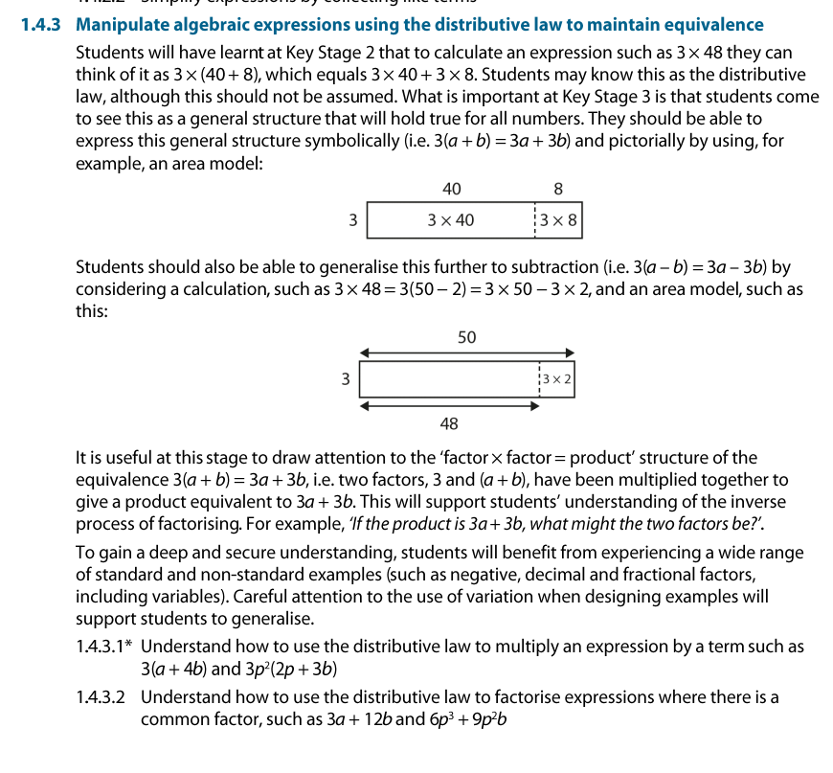
1.4.3.1 Understand how to use the distributive law to multiply an expression by a term such as 3(a + 4b) and 3p²(2p + 3b)
Watch video one of Insights from experienced teachers | NCETM. Reflect upon their discussion – how does it compare to your experience of teaching this key idea?
You might want to particularly think about:
The use of the phrase ‘same value, different appearance’
Precision of language
Curriculum coherence
Using numerical examples as ‘scaffolds’

Slide 16
Understand the structure of the distributive law
Example 1
Calculate as efficiently as possible:
16 × 101
25 × 10 010
143 × 100 001
Notes:
Suggested questioning:
What do you notice about each question? How can you calculate it most efficiently?
What property/rule are you using here? How could you write out what you have done?
Can you write another question that can be solved in a similar way?
Things for you to think about:
In Example 1, students could simply answer the questions mechanistically. However, students should be encouraged to notice the additions inherent in the multipliers 101 (100 + 1), 10 010 (10 000 + 10) and 100 001 (100 000 + 1), and use these to calculate an answer efficiently. You could ask students to create their own examples and set them for a partner.

Slide 17
Understand the structure of the distributive law
Example 1
  How are your students likely to approach this problem?
  If they are likely to try and approach it mechanistically, how might you model a more efficient method to students? Will you make the link to the distributive law explicit? Why or why not?
Calculate as efficiently as possible:
16 × 101
25 × 10 010
143 × 100 001
Notes:
This example can be found on pages 18 and 19 of the 1.4 Core Concept document.

Slide 18
Understand the impact of the multiplier
Example 2
For each of these expressions, write another expression without brackets that will always have the same value.
1(3a + 5)
2(3a + 5)
3(3a + 5)
10(3a + 5)
Notes:
Suggested questioning:
Could you use a visual representation to show how your expressions have a different appearance but the same value?
What do you notice about your answers to a), b) and c)?
What factor is shared by all of the expressions?
Can you see the ‘3a + 5’ in all of your expressions?
Things for you to think about:
Students may find it useful to consider a visual representation for each expression. For example, part b) could be represented as a bar model and part d) could be represented using an area model (see slide 20).
The questions in Example 2 have been chosen to allow students to notice the impact that the multiplier has on both terms inside the brackets.
Students may begin answering parts a), b), and c) by using repeated addition instead of multiplication. It will be important to prompt students to see that multiplication can also be used and to realise that this is a more efficient method, particularly in part d).

Slide 19
Understand the impact of the multiplier
Example 2
  Consider the variation in this example: what is the effect of keeping one factor the same each time?
  What discussions might arise from this example?
For each of these expressions, write another expression without brackets that will always have the same value.
1(3a + 5)
2(3a + 5)
3(3a + 5)
10(3a + 5)
Notes:
This example can be found on page 19 of the 1.4 Core Concept document.

Slide 20
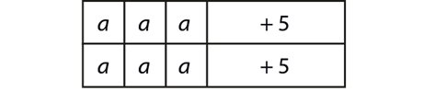
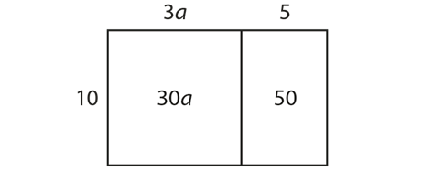
Understand the impact of the multiplier
Example 2 (cont’d)
  This is a bar model for part b:
  This is an area model for part d:
  How might you use visual representations such as these to support students’ understanding?
For each of these expressions, write another expression without brackets that will always have the same value.
1(3a + 5)
2(3a + 5)
3(3a + 5)
10(3a + 5)
Notes:
This example can be found on page 19 of the 1.4 Core Concept document.

Slide 21
Understand the impact of the multiplier
Example 3
Write an equivalent expression without brackets.
10(2xy + z)
10(a + 2b + 4c)
10(p² + 3q)
Notes:
Suggested questioning:
What is the same about all of your expressions? What is different?
What factor do all your terms share?
Could you use a visual representation to show how your expressions have a different appearance but the same value?
Things for you to think about:
In Example 3, students may notice that every term in the equivalent expression is a multiple of ten. Their attention should be drawn to this is to help reinforce the idea that every term inside the brackets is multiplied by the factor.

Slide 22
Understand the impact of the multiplier
Example 3
  Consider the variation in this example: what is the effect of keeping one factor the same each time?
  What discussions might arise from this example?
  How might these be the same or different to discussions arising from Example 2?
Write an equivalent expression without brackets.
10(2xy + z)
10(a + 2b + 4c)
10(p² + 3q)
Notes:
This example can be found on page 19 of the 1.4 Core Concept document.

Slide 23
Understand that the multiplier can be a variable
Example 4
Use the distributive law to write equivalent expressions for these expressions.
    2(b + 7)
    200(b + 7)
    2a(b + 7)
    2a²(b + 7)
    2a²b(b + 7)
Notes:
Suggested questioning:
In discussing these questions as a class, it will be helpful to ask students, ‘Can you “see” the b + 7 in each answer?’ You could ask, for example:
‘Can you see the b + 7 in 2b + 14?’
‘Can you see the b + 7 in 2a²b + 14a²?’
Things for you to think about:
The choice of what to keep the same and what to vary in Example 4 can help students to spot patterns and consider the mathematical structures behind the calculations.
You could encourage students to draw diagrams (a bar model or an area model) to justify their answers and to critique the answers of other students where they feel there are mistakes.
Students could be presented with possible answers and be challenged to find the question, e.g. 2a²bc + 14a²c. Note, it will be important for students to see factorising as the inverse process of multiplying two expressions together.
Ensure students can verbalise their method accurately, using key mathematical terms. For example, ‘Every term inside the brackets is multiplied by the term outside’.

Slide 24
Understand that the multiplier can be a variable
Example 4
  Consider the variation in this example: what is the effect of keeping one factor the same each time? How does it differ from Examples 2 and 3?
  What might be the impact of asking students to ‘write equivalent expressions’ rather than ‘the answer’? Is this an important distinction to make?
Use the distributive law to write equivalent expressions for these expressions.
    2(b + 7)
    200(b + 7)
    2a(b + 7)
    2a²(b + 7)
    2a²b(b + 7)
Notes:
This example can be found on pages 19 and 20 of the 1.4 Core Concept document.

Slide 25
Understand the importance of the sign (positive or negative) of each term in an expression and how it affects the final result
Example 5
Write an equivalent expression without brackets.
(The questions in this example are ordered vertically, down the page.)
2a(3c + 5b)
2a(5b + 3c)
2a(3c − 5b)
2a(5b − 3c)
2a(–5b + 3c)
–2a(5b − 3c)
–2a(3c − 5b)
Notes:
Suggested questioning:
What is the same and what is different each time?
How could you represent each of these examples?
Things for you to think about:
The use of variation in Example 5 is to draw students’ attention to the signs of each term in the expression. You could draw attention to when answers are the same and when they are not by asking, for example, ‘Why is
2a(5b − 5c) not the same as 2a(5c − 5b) but is the same as 2a(−5c + 5b)?’
The use of an area model diagram (as in Example 2) alongside the purely symbolic form will support students’ understanding here.

Slide 26
Understand the importance of the sign (positive or negative) of each term in an expression and how it affects the final result
Example 5
  How does this example compare to previous exercises you may have given your students to practise ‘expanding brackets’?
  What might you want to draw students’ attention to when discussing the expressions?
  Could you write your own similar set of questions?
Write an equivalent expression without brackets.
2a(3c + 5b)
2a(5b + 3c)
2a(3c − 5b)
2a(5b − 3c)
2a(–5b + 3c)
–2a(5b − 3c)
–2a(3c − 5b)
Notes:
This example can be found on page 20 of the 1.4 Core Concept document.

Slide 27
Understand the importance of the sign (positive or negative) of each term in an expression and how it affects the final result
Example 6
Which expression is correct? Justify your answer.
Expand 8p(2pq − 3p).
16p²q + 5p
10p²q + 5
16p²q − 24p²
16p²q + 24p²
Notes:
Suggested questioning:
What might someone have done wrong in the incorrect answers? Why might they have thought this? What advice would you give to these students?
Can you write an expression with brackets that is equivalent to each of the incorrect answers?
Things for you to think about:
Example 6 has been designed to help students clarify the concept by testing ‘what it is’ as well as ‘what it’s not’. The options are carefully chosen to address various misconceptions.
In choosing part a) students may have incorrectly added the multiplier to the final term and performed 8 + (−3) instead of multiplying them.
The answer in part b) has been reached by adding eight to each number seen rather than multiplying.
Part c) is the correct expansion and in part d) students may have ignored the negative sign in the brackets. Asking students to explain why options are incorrect will help them develop their reasoning skills.

Slide 28
Understand the importance of the sign (positive or negative) of each term in an expression and how it affects the final result
Example 6
  What are the benefits of exposing students to non-examples generated from common misconceptions? Are there any potential drawbacks?
  Generate a set of examples and non-examples for another expression. What misconceptions are you challenging?
Which expression is correct? Justify your answer.
Expand 8p(2pq − 3p).
16p²q + 5p
10p²q + 5
16p²q − 24p²
16p²q + 24p²
Notes:
This example can be found on pages 20 and 21 of the 1.4 Core Concept document.

Slide 29
Understand the importance of the sign (positive or negative) of each term in an expression and how it affects the final result
Example 7
Samira says that to expand 5e²f(4g − 3) you first do 5e²f × 4g and then 5e²f × 3. Is she correct?
Jeremiah says that to expand –5e²f(4g − 3) you first do –5e²f × 4g and then –5e²f × 3. Is he correct?
Notes:
Suggested questioning:
What have these students done right? What have they done wrong?
How would you explain this?
What is the same and different about each expression? What should be the same and different about the equivalent expressions without brackets?
Things for you to think about:
Example 7 has been chosen to test students’ understanding of the concept and addresses misconceptions that can arise when students learn a procedure (multiply the terms in the brackets with the term at the front and put the same sign in the middle). While that method might work for part a) it does not work for part b). Showing students examples of both ‘what it is’ and ‘what it’s not’ will help develop a deeper understanding of the concept.
This example also encourages students to verbalise their methods clearly. Part a) would lead to the correct answer if Samira went on to put a negative sign between the terms, but would be improved upon if she had considered she was really multiplying the 5e²f by negative three.

Slide 30
Understand the importance of the sign (positive or negative) of each term in an expression and how it affects the final result
Example 7
  Students will need to be confident and fluent with manipulating negative numbers when tackling these questions. How could you assess this before starting work on this example?
  Getting students to discuss and explain why statements are incorrect, or asking them to improve upon given answers, are strategies to encourage reasoning (a fundamental aim of the national curriculum). What routines might you want to have in place in your classroom to facilitate these discussions?
Samira says that to expand 5e²f(4g − 3) you first do 5e²f × 4g and then 5e²f × 3. Is she correct?
Jeremiah says that to expand –5e²f(4g − 3) you first do –5e²f × 4g and then –5e²f × 3. Is he correct?
Notes:
This example can be found on page 21 of the 1.4 Core Concept document.

Slide 31
Understand the impact of a negative multiplier on the result
Example 8
Expand these brackets.
(The questions in this example are ordered vertically, down the page.)
-2a(9d + 4b)
-2a(9d – 4b)
-1a(9d + 4b)
-1a(9d – 4b)
-a(4b – 9d)
Notes:
Suggested questioning:
What is the same/different between a) and b)? And how about c) and d)?
What is the same/different about part e)?
Things for you to think about:
Example 8 provides an opportunity to assess students’ understanding when dealing with negative numbers. Parts a) and b) and parts c) and d) are paired so students notice what happens to the final term when multiplied by a negative number. Students should notice the difference in how the multiplier is written for part e) compared with part d) and understand what this means. Part e) also has a different order of terms within the brackets. Small changes like this are important to encourage students to stop and think deeply about what they are doing. Again, using the same numbers throughout will help students to focus on what is varying in each question.

Slide 32
Understand the impact of a negative multiplier on the result.
Example 8
  This is another example of careful variation: the numbers are kept the same to help students to focus on what is varying. What are the key learning points in this example?
  What other key learning points would you want to expose your students to? Design a set of questions that will focus students’ attention on these points.
Expand these brackets.
-2a(9d + 4b)
-2a(9d – 4b)
-1a(9d + 4b)
-1a(9d – 4b)
-a(4b – 9d)
Notes:
This example can be found on pages 21 and 22 of the 1.4 Core Concept document.

Slide 33
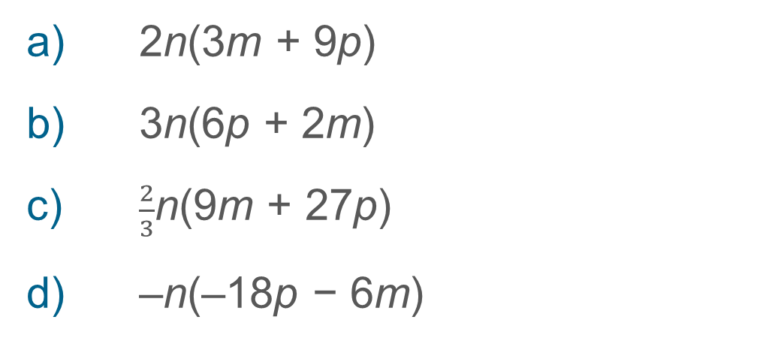
Understand the impact of a negative multiplier on the result
Example 9
Expand these brackets. Which expression is the odd one out?
a) 2n(3m + 9p)
b) 3n(6p + 2m)
c) $\frac{2}{3}$n(9m + 27p)
d) –n(–18p − 6m)
Notes:
Suggested questioning:
What is the same about all of these questions? What is different?
Could you write another expression that is equivalent?
Things for you to think about:
All parts of Example 9 have the same answer. By doing these questions, students should appreciate that different expansions (with different multipliers, different terms inside the brackets, different order of terms, different signs) can result in the same expression. Students should be given opportunities to verbalise their mathematical thinking, and questions that do not have an obvious correct answer are good ways to challenge their understanding.
This example could prompt conversations about common factors – parts a) and c) could have a factor of three taken out of the brackets, part d) could have a factor of negative six taken out of the brackets. This links to future work on factorising, so be mindful not to progress students onto a new topic. Part d) would normally not be written in this way, so discussions about standard notation may also develop.

Slide 34
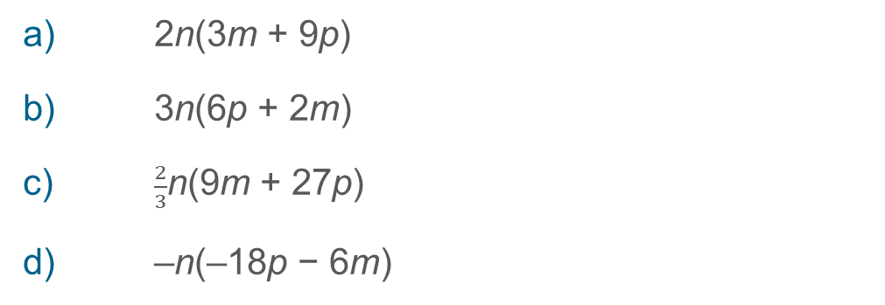
Understand the impact of a negative multiplier on the result
Example 9
  What conversations might arise as a result of this task?
  What other expressions might you want to add to this set?
  What might you want students to do next?
Expand these brackets. Which expression is the odd one out?
a) 2n(3m + 9p)
b) 3n(6p + 2m)
c) $\frac{2}{3}$n(9m + 27p)
d) –n(–18p − 6m)
Notes:
This example can be found on page 22 of the 1.4 Core Concept document.

Slide 35

Apply knowledge of fractions and decimals when expanding brackets
Example 10
Expand these brackets.
    0.1x(80y + 30xy)
    0.2e(5e − 7f)
    $\frac{1}{2}$v(3u – $\frac{1}{3}$v)
    $−\frac{4}{5}$p(5q + 4p)
    $−1\frac{3}{4}$(4 – $\frac{4}{7}$d)
Notes:
Suggested questioning:
Which of these questions do you think looks the most challenging? Why?
What is the same about each question?
Can you simplify your terms?
Things for you to think about:
Example 10 provides an opportunity to make connections with work on decimals and fractions. It allows students to see that the concept of expanding brackets can be applied to seemingly more complicated numbers, but the structure remains the same.
It could be a good strategy for challenging students while still keeping them working on the same topic. Asking students to develop their own questions and answers is another way of promoting deeper thinking.
In part a) the multiplier is a decimal, but the terms inside the brackets have been carefully chosen so that students can perform the multiplications easily and the answers are integers.
In part b) the multiplier is again a decimal, but the linear coefficient is the final term and the numbers are more complicated, so students will need to think carefully about how they express their answer.
Part c) has a fractional multiplier, so students will need to be comfortable with multiplying fractions by integers and other fractions.
In part d) the fractional multiplier is not a unit fraction and terms can be simplified after multiplying. The terms are also not in the ‘standard’ format.
In part e) the multiplier is a negative mixed number and terms can again be simplified.
In all questions, a range of letters has been used for the linear unknown so that students become familiar at dealing with letters other than a or x.

Slide 36

Apply knowledge of fractions and decimals when expanding brackets
Example 10
  Think about when you have taught this topic in the past: did students apply their knowledge of expanding brackets to non-integers? Why or why not?
  What are the benefits of including examples with seemingly ‘more complicated’ numbers? What are the challenges?
  What might your students find challenging about these questions? What can you do to support them?
Expand these brackets.
    0.1x(80y + 30xy)
    0.2e(5e − 7f)
    $\frac{1}{2}$v(3u – $\frac{1}{3}$v)
    $−\frac{4}{5}$p(5q + 4p)
    $−1\frac{3}{4}$(4 – $\frac{4}{7}$d)
Notes:
This example can be found on pages 22 and 23 of the 1.4 Core Concept document.

Slide 37
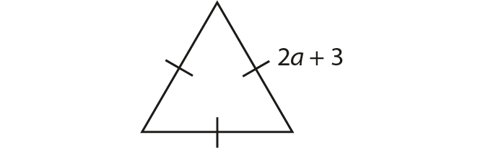

Apply the use of algebra to a different context
Example 11
a) Use brackets to write an expression for the perimeter of these shapes.
i)
ii)
A regular polygon with n sides each of length 7 − 3p.
b) Use brackets to write an expression for the area of this rectangle.
Notes:
Suggested questioning:
Can you create an example like this for other shapes?
What are the two factors in each example? Can you write the expression with and without brackets?
What polygon do you imagine?
Things for you to think about:
Example 11 is designed to allow students to see how algebra could be applied in different contexts. Students may recognise that there is more than one method for finding the perimeter or area, and discussions could then focus on whether using brackets might provide a more efficient method. Applying algebra to other topics, such as perimeter and area, will help students realise that algebra is not a standalone concept but permeates many other areas of mathematics.

Slide 38
Apply the use of algebra to a different context
Example 11
  Do you need to recap perimeter and area with your classes, so that all students can engage in this question?
  Can you think of any other contexts where expanding brackets might be used? Consider your Schemes of Learning; this might provide an opportunity to revisit previous topics in different contexts.
Use brackets to write an expression for the perimeter of these shapes.
i)
ii)
A regular polygon with n sides each of length 7 − 3p.
Use brackets to write an expression for the area of this rectangle.
Notes:
This example can be found on page 23 of the 1.4 Core Concept document.

Slide 39
Reflection questions
What other mathematical concepts will be supported by students’ stronger understanding of this key idea?
What mathematical language will you continue to use to support pupils to make connections with other areas?
Which representations might you continue to use to further develop students’ understanding?

Slide 41
Appendices
You may choose to use the following slides when planning or delivering a PD session. They cover:
  Key vocabulary
  Representations and structure
  Previous learning
  Future learning
  Library of links

Slide 42
Key vocabulary (1)
Term | Definition
binomial | An algebraic expression of the sum or difference of two terms.
equation | A mathematical statement showing that two expressions are equal. The expressions are linked with the symbol = Examples: 7 – 2 = 4 + 1 4x = 3 x² − 2x + 1 = 0
expression | A mathematical form expressed symbolically. Examples: 7 + 3 a² + b²
factorise | To express a number or a polynomial as the product of its factors. Example 1: Factorising 12: 12 = 1 × 12 = 2 × 6 = 3 × 4 The factors of 12 are 1, 2, 3, 4, 6 and 12. 12 may be expressed as a product of its prime factors: 12 = 2 × 2 × 3 Example 2: Factorising x² − 4x − 21: x² − 4x – 21 = (x + 3)(x − 7) The factors of x² − 4x – 21 are (x + 3) and (x − 7).

Slide 43
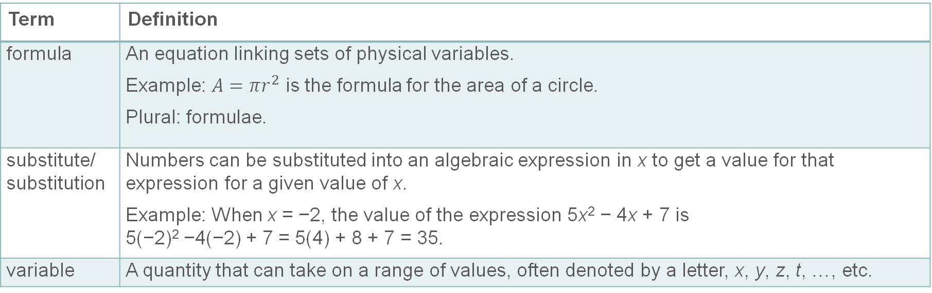
Key vocabulary (2)
Term | Definition
formula | An equation linking sets of physical variables. Example: $A=πr^{2}$ is the formula for the area of a circle. Plural: formulae.
substitute/ substitution | Numbers can be substituted into an algebraic expression in x to get a value for that expression for a given value of x. Example: When x = −2, the value of the expression 5x² − 4x + 7 is 5(−2)² −4(−2) + 7 = 5(4) + 8 + 7 = 35.
variable | A quantity that can take on a range of values, often denoted by a letter, x, y, z, t, …, etc.

Slide 44
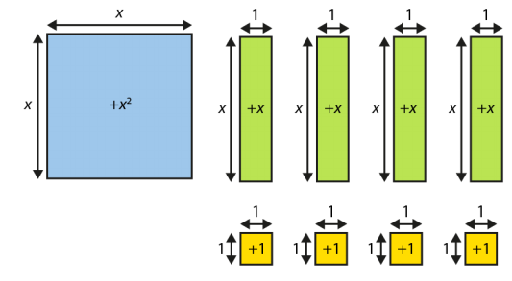
Representations and structure
There are a number of different representations that you may wish to use to support students’ understanding of this key idea. These might include:
Bar models
  Bar models can be very useful to support students in representing (literally, re-presenting) problems to reveal additive and multiplicative structures, including those involving unknown values.
Algebra tiles
  Although not offering a generalised image of a variable (x is represented by an actual length and will necessarily be seen as a particular length relative to the ‘1’), algebra tiles can provide a useful representation for expressions and give meaning to certain symbolic manipulations.
Notes:
More information about the representations and structure involved in this key idea can be found:
On page 8 of the The Structure of the number system Theme Overview document
Within the NCETM’s Using Mathematical Representations at KS3 documents
Links to all of these can be found on the final slide.

Slide 45
Previous learning
From Upper Key Stage 2, students will bring experience of:
reading, writing, ordering and comparing numbers up to 10 000 000 and determining the value of each digit
rounding any whole number to a required degree of accuracy
using negative numbers in context
identifying the value of each digit in numbers given to three decimal places and multiplying and dividing numbers by 10, 100 and 1 000, giving answers up to three decimal places
using, reading, writing and converting between standard units, converting measurements of length, mass, volume and time from a smaller unit of measure to a larger unit and vice versa, using decimal notation up to three decimal places
using symbols and letters to represent variables and unknowns in mathematical situations that they already understand, such as:
  missing numbers, lengths, coordinates and angles
  formulae in mathematics and science
Notes:
Theme 1 The structure of the number system

Slide 46
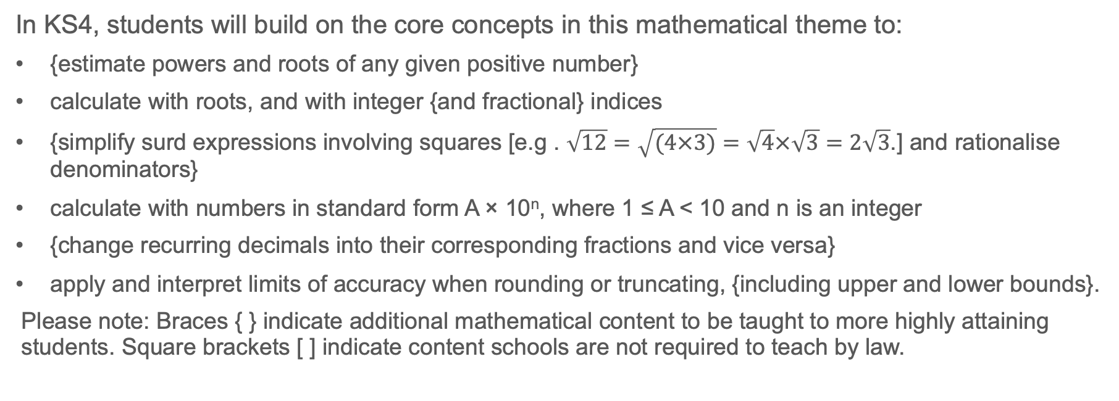
Future learning
In KS4, students will build on the core concepts in this mathematical theme to:
{estimate powers and roots of any given positive number}
calculate with roots, and with integer {and fractional} indices
{simplify surd expressions involving squares [e.g . $\sqrt{12}=\sqrt{(4×3)}=\sqrt{4}×\sqrt{3}=2\sqrt{3}$.] and rationalise denominators}
calculate with numbers in standard form A × 10^{n}, where 1 ≤ A < 10 and n is an integer
{change recurring decimals into their corresponding fractions and vice versa}
apply and interpret limits of accuracy when rounding or truncating, {including upper and lower bounds}.
Please note: Braces { } indicate additional mathematical content to be taught to more highly attaining students. Square brackets [ ] indicate content schools are not required to teach by law.
Notes:
Theme 1 The structure of the number system

Slide 47
Library of links
The following resources from the NCETM website have been referred to within this slide deck:
  NCETM Secondary Mastery Professional Development
    1 The Structure of the number system Theme Overview Document
    1.4 Simplifying and manipulating expressions, equations and formulae Core Concept Document
  Using mathematical representations at KS3 | NCETM
  Insights from experienced teachers | NCETM
  NCETM primary mastery professional development materials
  NCETM primary assessment materials
  NCETM secondary assessment materials

