Slide 1
2.13 Calculation: multiplying and dividing by 10 or 100
Representations | Year 4
Multiplication and Division

Slide 2
How to use this presentation
You can find the teacher guide 2.13 Calculation: multiplying and dividing by 10 or 100 by following the link below.

Slide 3
2.13 Calculation: ×/÷ 10 or 100 Step 1:1
Emily has 1 pencil; Jamie has 10 times as many.
How many pencils does Jamie have?
Notes:
For every one pencil of Emily’s, Jamie has ten.
Think of ‘1’ and make it ten times the size.
Think of ‘1’ and multiply by ten.
1 × 10
One multiplied by ten is equal to ten.
1 × 10 =10
Ten is ten times the size of one.
Ten pencils is ten times as many as one pencil.
Jamie has ten pencils.

Slide 4
2.13 Calculation: ×/÷ 10 or 100 Step 1:1
Emily has 2 pencils; Jamie has 10 times as many.
How many pencils does Jamie have?
Notes:
For every one pencil of Emily’s, Jamie has ten.
Think of ‘2’ and make it ten times the size.
Think of ‘2’ and multiply by ten.
2 × 10
Two multiplied by ten is equal to twenty.
2 × 10 = 20
Twenty is ten times the size of two.
Twenty pencils is ten times as many as two pencils.
Jamie has twenty pencils.

Slide 5
2.13 Calculation: ×/÷ 10 or 100 Step 1:1
Emily has 3 pencils; Jamie has 10 times as many.
How many pencils does Jamie have?
Notes:
For every one pencil of Emily’s, Jamie has ten.
Think of ‘3’ and make it ten times the size.
Think of ‘3’ and multiply by ten.
3 × 10
Three multiplied by ten is equal to thirty.
3 × 10 = 30
Thirty is ten times the size of three.
Thirty pencils is ten times as many as three pencils.
Jamie has thirty pencils.

Slide 6
2.13 Calculation: ×/÷ 10 or 100 Step 1:2

Slide 7
2.13 Calculation: ×/÷ 10 or 100 Step 1:2

Slide 8
2.13 Calculation: ×/÷ 10 or 100 Step 1:3
1
2
3
4
5
6
7
8
9
× 10
= 10
= 20
= 30
= 40
= 50
= 60
= 70
= 80
= 90

Slide 9
2.13 Calculation: ×/÷ 10 or 100 Step 1:3
× 10

Slide 10
2.13 Calculation: ×/÷ 10 or 100 Step 1:4
1,000s | 100s | 10s | 1s
10 times the size
10 times the size
10 times the size

Slide 11
2.13 Calculation: ×/÷ 10 or 100 Step 1:4
1,000s | 100s | 10s | 1s
1
1
1
1
1
1
1
10 times the size
10 times the size
10 times the size

Slide 12
2.13 Calculation: ×/÷ 10 or 100 Step 1:4
6 × 10 =
60
1,000s | 100s | 10s | 1s
6
6
↓ × 10
6
0
6
Think of ‘6’ and make it ten times the size.
10 times the size
10 times the size
10 times the size

Slide 13
2.13 Calculation: ×/÷ 10 or 100 Step 1:5
× 10

Slide 14
2.13 Calculation: ×/÷ 10 or 100 Step 1:5
0
1
2
3
4
5
6
7
8
9
× 10
0
10
20
30
40
50
60
70
80
90

Slide 15
2.13 Calculation: ×/÷ 10 or 100 Step 1:6
12 × 10 =
120
Notes:
I have twelve. This is one ten and two ones.
How much will I have if I have ten times this amount?
Think of twelve and make it ten times the size.
Think of twelve and multiply by ten.
12 × 10
We have:
ten tens; that’s one hundred
twenty ones; that’s twenty.
Twelve multiplied by ten is equal to one hundred and twenty.
12 × 10 = 120
One hundred and twenty is ten times the size of twelve.

Slide 16
2.13 Calculation: ×/÷ 10 or 100 Step 1:7
12 × 10 =
120
1,000s | 100s | 10s | 1s
2
1
2
1
↓ × 10
2
0
1
1
2
Think of ‘12’ and make it ten times the size.
10 times the size
10 times the size
10 times the size
Notes:
Step 1 – move each of the digits one place to the left.
Step 2 – put a ‘0’ in the ones place.

Slide 17
2.13 Calculation: ×/÷ 10 or 100 Step 1:7
12 | × | 10 |  | = | 120
What is the value of the ‘2’ in ‘12’?
What is the value of the ‘2’ in ‘120’?
‘two’
‘twenty’
2
20
What is the value of the ‘1’ in ‘12’?
What is the value of the ‘1’ in ’120’?
‘ten’
‘one hundred’
10
100
We had 12 ones. We now have 12 tens.
Notes:
Summarise and compare the value of the digits.

Slide 18
2.13 Calculation: ×/÷ 10 or 100 Step 1:8
100
110
120
130
140
150
160
170
180
190
10 × 10 =
200
11 × 10 =
12 × 10 =
13 × 10 =
14 × 10 =
15 × 10 =
16 × 10 =
17 × 10 =
18 × 10 =
19 × 10 =
20 × 10 =

Slide 19
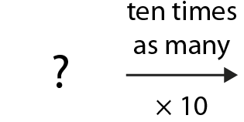
2.13 Calculation: ×/÷ 10 or 100 Step 2:1
Jamie has 10 pencils; he has 10 times as many as Emily.
How many pencils does Emily have?
10 times as many
× 10
Notes:
One multiplied by ten is equal to ten.
1 × 10 = 10
Ten divided by ten is equal to one.
10 ÷ 10 = 1
Ten is ten times the size of one.
Emily has one pencil.

Slide 20
2.13 Calculation: ×/÷ 10 or 100 Step 2:1
Jamie has 20 pencils; he has 10 times as many as Emily.
How many pencils does Emily have?
10 times as many
× 10
Notes:
Two multiplied by ten is equal to twenty.
2 × 10 = 20
Twenty divided by ten is equal to two.
20 ÷ 10 = 2
Twenty is ten times the size of two.
Emily has two pencils.

Slide 21
2.13 Calculation: ×/÷ 10 or 100 Step 2:1
Jamie has 30 pencils; he has 10 times as many as Emily.
How many pencils does Emily have?
10 times as many
× 10
Notes:
Three multiplied by ten is equal to thirty.
3 × 10 = 30
Thirty divided by ten is equal to three.
30 ÷ 10 = 3
Thirty is ten times the size of three.
Emily has three pencils.

Slide 22
2.13 Calculation: ×/÷ 10 or 100 Step 2:2
× 10
÷ 10
1 × 10 = 10
2 × 10 = 20
3 × 10 = 30
4 × 10 = 40
5 × 10 = 50
6 × 10 = 60
7 × 10 = 70
8 × 10 = 80
9 × 10 = 90
10 ÷ 10
20 ÷ 10
30 ÷ 10
40 ÷ 10
50 ÷ 10
60 ÷ 10
70 ÷ 10
80 ÷ 10
90 ÷ 10
= 1
= 2
= 3
= 4
= 5
= 6
= 7
= 8
= 9

Slide 23
2.13 Calculation: ×/÷ 10 or 100 Step 2:2
× 10
÷ 10

Slide 24
2.13 Calculation: ×/÷ 10 or 100 Step 2:2
90 ÷ 10 =
9
1,000s | 100s | 10s | 1s
9
9
9
0
0
↓ ÷ 10
9
0
10 times the size
10 times the size
10 times the size
Notes:
Step 1 – move each of the digits one place to the right.
Step 2 – remove zero.

Slide 25
2.13 Calculation: ×/÷ 10 or 100 Step 2:4
40 ÷ 10 =
4
4 tens
40
4 ones
4
Notes:
I have forty. This is four tens.
How much will I have if I divide by ten?
We had four tens. We now have four ones.
Four tens divided by ten is equal to four ones.
Forty divided by ten is equal to four.

Slide 26
2.13 Calculation: ×/÷ 10 or 100 Step 2:5
× 10
÷ 10

Slide 27
2.13 Calculation: ×/÷ 10 or 100 Step 2:5
0
1
2
3
4
5
6
7
8
9
÷ 10
0
10
20
30
40
50
60
70
80
90

Slide 28
2.13 Calculation: ×/÷ 10 or 100 Step 2:6
160 ÷ 10 =
16
1 hundred and 6 tens
160
1 ten and 6 ones
16
Notes:
I have one hundred and sixty.
This is one hundred and six tens.
How much will I have if I divide by ten?

Slide 29
2.13 Calculation: ×/÷ 10 or 100 Step 2:6
160 ÷ 10 =
16
× 10
× 10
× 10
1,000s | 100s | 10s | 1s
6
0
1
1
6
6
0
0
↓ ÷ 10
1
6
0
÷ 10
÷ 10
÷ 10
Notes:
Step 1 – move each of the digits one place to the right.
Step 2 – remove zero.

Slide 30
2.13 Calculation: ×/÷ 10 or 100 Step 2:6
160 | ÷ | 10 |  | = | 16
What is the value of the ‘6’ in ‘160’?
What is the value of the ‘6’ in ‘16’?
‘sixty’
‘six’
60
6
What is the value of the ‘1’ in ‘160’?
What is the value of the ‘1’ in ‘16’?
‘one hundred’
‘ten’
100
10
We had 16 tens. We now have 16 ones.
Notes:
Step 3 - Summarise and compare the value of the digits.

Slide 31
2.13 Calculation: ×/÷ 10 or 100 Step 2:7
÷ 10
10
11
12
13
14
15
16
17
18
19
140 ÷ 10 =
20
100 ÷ 10 =
110 ÷ 10 =
120 ÷ 10 =
130 ÷ 10 =
150 ÷ 10 =
160 ÷ 10 =
170 ÷ 10 =
180 ÷ 10 =
190 ÷ 10 =
200 ÷ 10 =

Slide 32
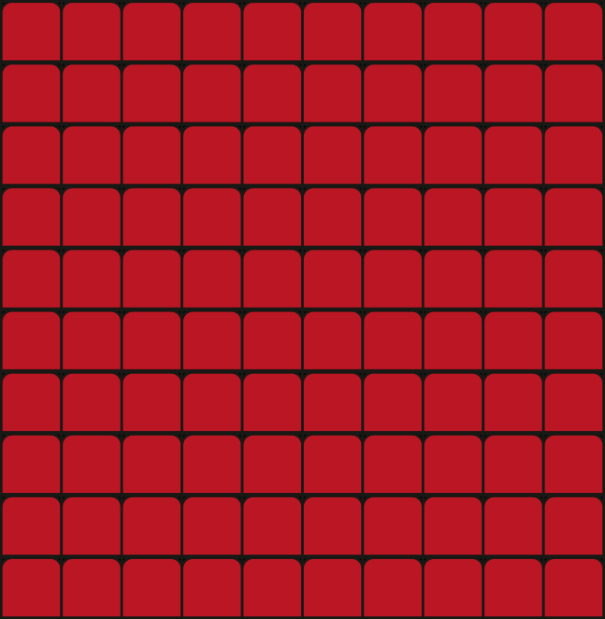
2.13 Calculation: ×/÷ 10 or 100 Step 3:1
This afternoon there was 1 person in the cinema. This evening there are 100 times as many. How many people in the cinema this evening?
Notes:
Think of ‘1’ and make it one hundred times the size.
Think of ‘1’ and multiply by one hundred.
1 × 100
One multiplied by one hundred is equal to one hundred.
1 × 100 = 100
One hundred is one hundred times the size of one.
One hundred people is one hundred times as many as one person.
There are one hundred people in the cinema this evening.

Slide 33
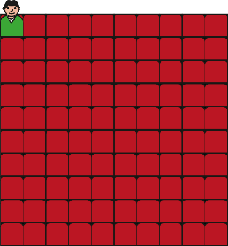
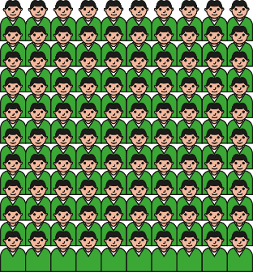
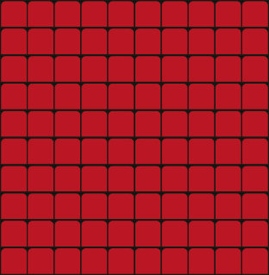
2.13 Calculation: ×/÷ 10 or 100 Step 3:1
This afternoon there were 2 people in the cinema. This evening there are 100 times as many. How many people in the cinema this evening?
Notes:
Think of ‘2’ and make it one hundred times the size.
Think of ‘2’ and multiply by one hundred.
2 × 100
Two multiplied by one hundred is equal to two hundred.
2 × 100 = 200
Two hundred is one hundred times the size of two.
Two hundred people is one hundred times as many as two people.
There are two hundred people in the cinema this evening.

Slide 34
2.13 Calculation: ×/÷ 10 or 100 Step 3:1
This afternoon there were 3 people in the cinema. This evening there are 100 times as many. How many people in the cinema this evening?
Notes:
Think of ‘3’ and make it one hundred times the size.
Think of ‘3’ and multiply by one hundred.
3 × 100
Three multiplied by one hundred is equal to three hundred.
3 × 100 = 300
Three hundred is one hundred times the size of three.
Three hundred people is one hundred times as many as three people.
There are three hundred people in the cinema this evening.

Slide 35
2.13 Calculation: ×/÷ 10 or 100 Step 3:3
1 × 100
2 × 100
3 × 100
4 × 100
5 × 100
6 × 100
8 × 100
9 × 100
7 × 100
= 100
= 200
= 300
= 400
= 500
= 600
= 700
= 800
= 900

Slide 36
2.13 Calculation: ×/÷ 10 or 100 Step 3:3
× 100

Slide 37
2.13 Calculation: ×/÷ 10 or 100 Step 3:4
1,000s | 100s | 10s | 1s
100 times the size

Slide 38
2.13 Calculation: ×/÷ 10 or 100 Step 3:4
1,000s | 100s | 10s | 1s
1
1
100 times the size

Slide 39
2.13 Calculation: ×/÷ 10 or 100 Step 3:4
6 × 100 =
600
1,000s | 100s | 10s | 1s
6
6
× 100
0
0
6
Think of ‘6’ and make it 100 times the size.

Slide 40
2.13 Calculation: ×/÷ 10 or 100 Step 3:5
× 100

Slide 41
2.13 Calculation: ×/÷ 10 or 100 Step 3:5
0
1
2
3
4
5
6
7
8
9
× 100
0
100
200
300
400
500
600
700
800
900

Slide 42
2.13 Calculation: ×/÷ 10 or 100 Step 3:6
15 × 100 =
1,500
1 ten and 5 ones
15
1 thousand and 5 hundreds
1,500
Notes:
Fifteen multiplied by one hundred is equal to one thousand five hundred.
15 × 100 = 1,500
One thousand five hundred is one hundred times the size of fifteen.

Slide 43
2.13 Calculation: ×/÷ 10 or 100 Step 3:6
15 × 100 =
1,500
1,000s | 100s | 10s | 1s
1
1
5
5
× 100
0
1
0
5
Think of ‘15’ and make it 100 times the size.
100 times the size
100 times the size
Notes:
Step 1 – move each of the digits two places to the left.
Step 2 – introduce zeros in the tens and ones places.

Slide 44
2.13 Calculation: ×/÷ 10 or 100 Step 3:6
15 | × | 100 |  | = | 1,500
What is the value of the ‘5’ in ‘15’?
What is the value of the ‘5’ in ‘1,500’?
‘five’
‘five hundred’
5
500
What is the value of the ‘1’ in ‘15’?
What is the value of the ‘1’ in ‘1,500’?
‘ten’
‘one thousand’
10
1,000
We had 15 ones. We now have 15 hundreds.
Notes:
Step 3 - Summarise and compare the value of the digits.

Slide 45
2.13 Calculation: ×/÷ 10 or 100 Step 3:7
11 × 100 =
13 × 100 =
14 × 100 =
15 × 100 =
16 × 100 =
17 × 100 =
18 × 100 =
19 × 100 =
20 × 100 =
12 × 100 =
10 × 100 =
1,000
1,100
1,200
1,300
1,400
1,500
1,600
1,700
1,800
1,900
2,000

Slide 46
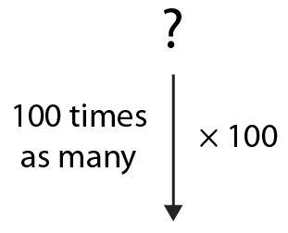
2.13 Calculation: ×/÷ 10 or 100 Step 4:1
This evening there are 100 people in the cinema, 100 times as many as this afternoon. How many were in the cinema this afternoon?
Notes:
One multiplied by one hundred is equal to one hundred.
1 × 100 = 100
One hundred divided by one hundred is equal to one.
100 ÷ 100 = 1
One hundred is one hundred times the size of one.
There was one person in the cinema.

Slide 47
2.13 Calculation: ×/÷ 10 or 100 Step 4:1
This evening there are 200 people in the cinema, 100 times as many as this afternoon. How many were in the cinema this afternoon?
Notes:
Two multiplied by one hundred is equal to two hundred.
2 × 100 = 200
Two hundred divided by one hundred is equal to two.
200 ÷ 100 = 2
Two hundred is one hundred times the size of two.
There were two people in the cinema.

Slide 48
2.13 Calculation: ×/÷ 10 or 100 Step 4:1
This evening there are 300 people in the cinema, 100 times as many as this afternoon. How many were in the cinema this afternoon?
Notes:
Three multiplied by one hundred is equal to three hundred.
3 × 100 = 300
Three hundred divided by one hundred is equal to three.
300 ÷ 100 = 3
Three hundred is one hundred times the size of three.
There were three people in the cinema.

Slide 49
2.13 Calculation: ×/÷ 10 or 100 Step 4:1
× 100
÷ 100
1 × 100 = 100
2 × 100 = 200
3 × 100 = 300
4 × 100 = 400
5 × 100 = 500
6 × 100 = 600
7 × 100 = 700
8 × 100 = 800
9 × 100 = 900
100 ÷ 100
200 ÷ 100
300 ÷ 100
400 ÷ 100
500 ÷ 100
600 ÷ 100
700 ÷ 100
800 ÷ 100
900 ÷ 100
= 1
= 2
= 3
= 4
= 5
= 6
= 7
= 8
= 9

Slide 50
2.13 Calculation: ×/÷ 10 or 100 Step 4:3
900 ÷ 100 =
9
1,000s | 100s | 10s | 1s
9
9
0
0
0
0
÷ 100
9
0
0
0
0
100 times the size
100 times the size

Slide 51
2.13 Calculation: ×/÷ 10 or 100 Step 4:3
900 | ÷ | 100 |  | = | 9
What is the value of the ‘9’ in ‘900’?
What is the value of the ‘9’ in ‘9’?
‘nine hundred’
‘nine’
900
9
We had 9 hundreds. We now have 9 ones.
Notes:
Summarise and compare the value of the digits.

Slide 52
2.13 Calculation: ×/÷ 10 or 100 Step 4:4
× 100
÷ 100

Slide 53
2.13 Calculation: ×/÷ 10 or 100 Step 4:4
0
1
2
3
4
5
6
7
8
9
÷ 100
0
100
200
300
400
500
600
700
800
900

Slide 54
2.13 Calculation: ×/÷ 10 or 100 Step 4:5
1,600 ÷ 100 =
16
1 thousand and 6 hundreds
1,600
1 ten and 6 ones
16

Slide 55
2.13 Calculation: ×/÷ 10 or 100 Step 4:5
1,600 ÷ 100 =
16
× 100
× 100
1,000s | 100s | 10s | 1s
1
1
6
6
0
0
0
0
÷ 100
1
6
0
0
0
0
÷ 100
÷ 100

Slide 56
2.13 Calculation: ×/÷ 10 or 100 Step 4:5
1,600 | ÷ | 100 |  | = | 16
What is the value of the ‘6’ in ‘1,600’?
What is the value of the ‘6’ in ‘16’?
‘six hundred’
‘six’
600
6
What is the value of the ‘1’ in ‘1,600’?
What is the value of the ‘1’ in ‘16’?
‘one thousand’
‘ten’
1000
10
We had 16 hundreds. We now have 16 ones.
Notes:
Summarise and compare the value of the digits.

Slide 57
2.13 Calculation: ×/÷ 10 or 100 Step 4:6
÷ 100
1,300 ÷ 100 =
1,400 ÷ 100 =
1,500 ÷ 100 =
1,600 ÷ 100 =
1,800 ÷ 100 =
1,000 ÷ 100 =
1,200 ÷ 100 =
1,900 ÷ 100 =
2,000 ÷ 100 =
1,700 ÷ 100 =
10
11
12
13
14
15
16
17
18
19
1,100 ÷ 100 =
20

Slide 58
2.13 Calculation: ×/÷ 10 or 100 Step 5:1
8 × 10 = 80
80 × 10 = 800
8 × 100 = 800
× 10
× 100
× 10
8 × 10 × 10 = 8 × 100

Slide 59
2.13 Calculation: ×/÷ 10 or 100 Step 5:2
× 10
× 10
1,000s | 100s | 10s | 1s
8
× 10
8
0
× 10
8
0
0
× 100

Slide 60
2.13 Calculation: ×/÷ 10 or 100 Step 5:3
13 × 10 = 130
130 × 10 = 1,300
13 × 100 = 1,300
× 10
× 100
× 10
13 × 10 × 10 = 13 × 100

Slide 61
2.13 Calculation: ×/÷ 10 or 100 Step 5:3
0
1
2
3
4
5
6
7
8
9
10
11
12
13
14
15
× 10
0
10
20
30
40
50
60
70
80
90
100
110
120
130
140
150
× 100
× 10
0
100
200
300
400
500
600
700
800
900
1,000
1,100
1,200
1,300
1,400
1,500

Slide 62
2.13 Calculation: ×/÷ 10 or 100 Step 5:4
700 ÷ 10 = 70
70 ÷ 10 = 7
700 ÷ 100 = 7
÷ 10
÷ 100
÷ 10

Slide 63
2.13 Calculation: ×/÷ 10 or 100 Step 5:5
÷ 10
÷ 10
1,000s | 100s | 10s | 1s
7
0
0
$÷$ 10
7
0
$÷$ 10
7
÷ 100

Slide 64
2.13 Calculation: ×/÷ 10 or 100 Step 5:6
1,200 ÷ 10 = 120
120 ÷ 10 = 12
1,200 ÷ 100 = 12
÷ 10
÷ 100
÷ 10

Slide 65
2.13 Calculation: ×/÷ 10 or 100 Step 5:6
0
1
2
3
4
5
6
7
8
9
10
11
14
14
14
15
÷ 10
0
10
20
30
40
50
60
70
80
90
100
110
120
130
140
150
÷ 100
÷ 10
0
100
200
300
400
500
600
700
800
900
1,000
1,100
1,200
1,300
1,400
1,500

Slide 66
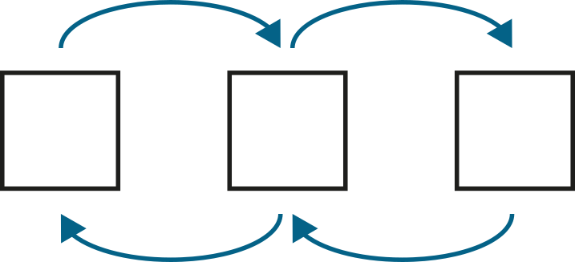
2.13 Calculation: ×/÷ 10 or 100 Step 5:7
Fill in the missing numbers.
× 10
× 10
× 10
× 10
6
3
60
30
600
300
$÷$ 10
$÷$ 10
$÷$ 10
$÷$ 10
$×$ 100
$×$ 100
6
3
600
300
$÷$ 100
$÷$ 100

Slide 67
2.13 Calculation: ×/÷ 10 or 100 Step 5:7
Fill in the missing numbers.

Slide 68
2.13 Calculation: ×/÷ 10 or 100 Step 6:1
1
×
1
=
1
×
10
×
10
1
×
10
=
10

Slide 69
2.13 Calculation: ×/÷ 10 or 100 Step 6:1
2
×
1
=
2
×
10
×
10
2
×
10
=
20

Slide 70
2.13 Calculation: ×/÷ 10 or 100 Step 6:1
1
×
2
=
2
×
10
×
10
1
×
20
=
20

Slide 71
2.13 Calculation: ×/÷ 10 or 100 Step 6:1
2
×
2
=
4
×
10
×
10
2
×
20
=
40

Slide 72
2.13 Calculation: ×/÷ 10 or 100 Step 6:1
1
×
3
=
3
×
10
×
10
1
×
30
=
30

Slide 73
2.13 Calculation: ×/÷ 10 or 100 Step 6:1
2
×
3
=
6
×
10
×
10
2
×
30
=
60

Slide 74
2.13 Calculation: ×/÷ 10 or 100 Step 6:1
3
×
4
=
12
×
10
×
10
3
×
40
=
120
Notes:
Three times four is equal to twelve, so
three times four tens is equal to twelve tens.

Slide 75
2.13 Calculation: ×/÷ 10 or 100 Step 6:2
4
×
2
=
8
×
10
×
10
40
×
2
=
80
Notes:
Four times two is equal to eight, so
four tens times two is equal to eight tens.

Slide 76
2.13 Calculation: ×/÷ 10 or 100 Step 6:2
3
×
5
=
15
×
10
×
10
30
×
5
=
150
Notes:
Three times four is equal to twelve, so
three times five is equal to fifteen tens.

Slide 77
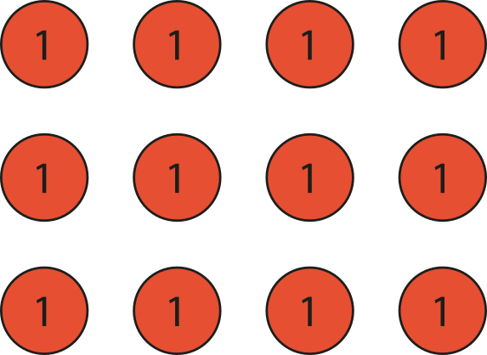
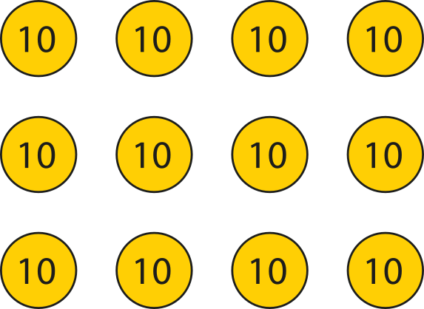
2.13 Calculation: ×/÷ 10 or 100 Step 6:3
4 classes of children. 30 children in each class.
How many children altogether?
4
×
3
=
12
×
10
×
10
4
×
30
=
120
Notes:
If there were four classes of three children, there would be twelve children altogether.
4 × 3 = 12
But there are four classes of thirty children; there are ten times
as many children in each class. So there are ten times as many children altogether.
12 × 10 = 120
4 × 30 = 120

Slide 78
2.13 Calculation: ×/÷ 10 or 100 Step 6:3
5
÷
5
=
1
×
10
×
10
50
÷
5
=
10

Slide 79
2.13 Calculation: ×/÷ 10 or 100 Step 6:5
10
÷
5
=
2
×
10
×
10
100
÷
5
=
20

Slide 80
2.13 Calculation: ×/÷ 10 or 100 Step 6:5
15
÷
5
=
3
×
10
×
10
150
÷
5
=
30

Slide 81
2.13 Calculation: ×/÷ 10 or 100 Step 6:5
12
÷
3
=
4
×
10
×
10
120
÷
3
=
40
Notes:
Twelve divided by three is equal to four, so
twelve tens divided by three is equal to four tens.

Slide 82
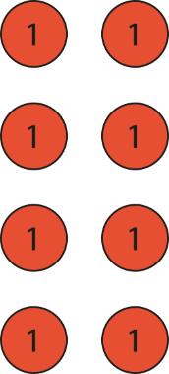
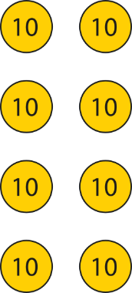
2.13 Calculation: ×/÷ 10 or 100 Step 6:6
80 children are going on a trip. There are 4 coaches. If the children are divided equally between the 4 coaches, how many are on each coach?
8
÷
4
=
2
×
10
×
10
80
÷
4
=
20
Notes:
If there were eight children divided between four coaches, there
would be two children on each coach.
8 ÷ 4 = 2
But there are eighty children divided between four coaches; there
are ten times as many children altogether.
So there are ten times as many children on each coach.
2 × 10 = 20
80 ÷ 4 = 20

Slide 83
2.13 Calculation: ×/÷ 10 or 100 Step 6:7
Complete the equations to describe the bar model.
50
+
50
+
50
=
150
3 ×
50
=
150
50 ×
3
=
150
150 ÷
3
=
50

Slide 84
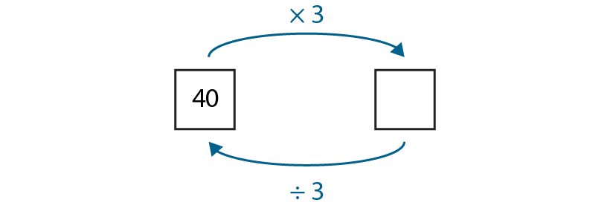
2.13 Calculation: ×/÷ 10 or 100 Step 6:7
Fill in the missing number.
40
120

Slide 85
2.13 Calculation: ×/÷ 10 or 100 Step 7:1
2
×
1
=
2
×
100
×
100
2
×
100
=
200

Slide 86
2.13 Calculation: ×/÷ 10 or 100 Step 7:1
2
×
2
=
4
×
100
×
100
2
×
200
=
400

Slide 87
2.13 Calculation: ×/÷ 10 or 100 Step 7:1
2
×
3
=
6
×
100
×
100
2
×
300
=
600

Slide 88
2.13 Calculation: ×/÷ 10 or 100 Step 7:1
3
×
4
=
12
×
100
×
100
3
×
400
=
1,200
Notes:
Three times four is equal to twelve, so
three times four hundreds is equal to twelve hundreds.

Slide 89
2.13 Calculation: ×/÷ 10 or 100 Step 7:2
3
×
5
=
15
×
100
×
100
300
×
5
=
1,500
Notes:
Three times five is equal to fifteen, so
three hundreds times five is equal to fifteen hundreds.

Slide 90
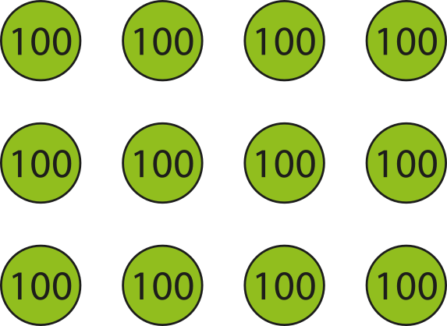
2.13 Calculation: ×/÷ 10 or 100 Step 7:3
4 jars of marbles. 300 marbles in each jar.
How many marbles altogether?
4
×
3
=
12
×
100
×
100
4
×
300
=
1,200
Notes:
If there were four jars of three marbles, there
would be twelve marbles altogether.
But there are four jars of three hundred marbles; there
are one hundred times as many marbles in each jar.
So there are one hundred times as many marbles altogether.
12 × 100 = 1200
4 × 300 = 1200

Slide 91
2.13 Calculation: ×/÷ 10 or 100 Step 7:5
3
÷
3
=
1
×
100
×
100
300
÷
3
=
100

Slide 92
2.13 Calculation: ×/÷ 10 or 100 Step 7:5
6
÷
3
=
2
×
100
×
100
600
÷
3
=
200

Slide 93
2.13 Calculation: ×/÷ 10 or 100 Step 7:5
9
÷
3
=
3
×
100
×
100
900
÷
3
=
300

Slide 94
2.13 Calculation: ×/÷ 10 or 100 Step 7:5
12
÷
3
=
4
×
100
×
100
1,200
÷
3
=
400
Notes:
Twelve divided by three is equal to four, so
twelve hundreds divided by three is equal to four hundreds.

Slide 95
2.13 Calculation: ×/÷ 10 or 100 Step 7:6
1,200 exercise books shared equally between 6 year groups.
How many books does each year group get?
12
÷
6
=
2
×
100
×
100
1,200
÷
6
=
200
Notes:
If there were twelve books divided between six year groups, there
would be two books for each year group.
12 ÷ 6 = 2
But there are twelve hundred books divided between six year groups; there
are one hundred times as many books altogether.
So each year group gets one hundred times as many books.
2 × 100 = 200
1,200 ÷ 6 = 200

Slide 96
2.13 Calculation: ×/÷ 10 or 100 Step 7:7
Complete the equations to describe the bar model.
600
+
600
+
600
=
1,800
3
×
600
=
1,800
600
×
3
=
1,800
1,800
÷
3
=
600

Slide 97
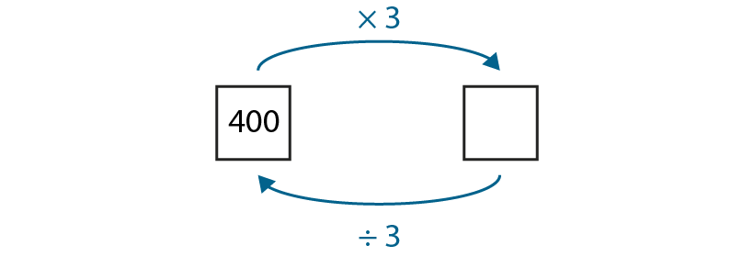
2.13 Calculation: ×/÷ 10 or 100 Step 7:7
Fill in the missing number.
400
1,200

