Slide 1
Numberblocks
Support Materials
Episode 9
Off We Go!

Slide 2
Practitioner Notes

Slide 3
Episode Description
Numberblocks One to Five decide to go off on a big adventure. They set off in order, chanting in verse, but keep getting out of order. Each time, they sound off in song to see if the order sounds right, then do a ‘diddly-do’ dance (like a do-si-do) to get back into the correct order. They walk through the sunshine then run through the forest, where Three disappears up a tree, reappears in the tree and juggles. They jump on boats and pretend to be pirates, then discover a tropical paradise. They don rubber rings and jump into the water.

Slide 4
Maths in the Episode
Ordering One of the 5 principles of counting (Gellman & Gallistel, 1978) includes awareness that the counting numbers are said in the same order each time. This is known as the ‘stable order’ principle. When the Numberblocks become muddled or one of the Numberblocks is missing then the number words sequence is no longer reliable. This episode will help children to identify a missing number in the forward sequence of counting numbers to 5 and to reorder the numbers when they become out of sequence.

Slide 5
Using Mathematical Language
During this episode children will experience what happens when the counting number sequence is muddled or a number is missing.
Encourage the children to use the counting number sequence to 5 in the correct order when you ask them: how many?
Develop the vocabulary of before and after:
One comes before Two
Four comes after Three
etc.

Slide 6
Talk and Discuss Together

Slide 7
Talk and Discuss Together
Watch the episode of Numberblocks. First ask the children what they noticed and allow them to talk to you and each other. The following slides are designed to stimulate children and adults to talk about the episode and draw out some key aspects of the mathematics.

Slide 8
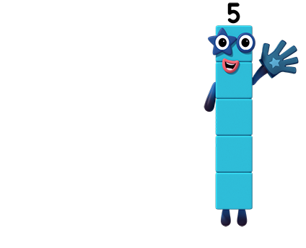
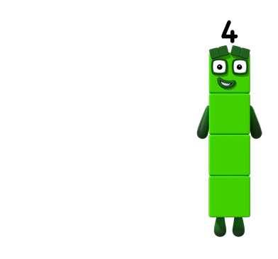
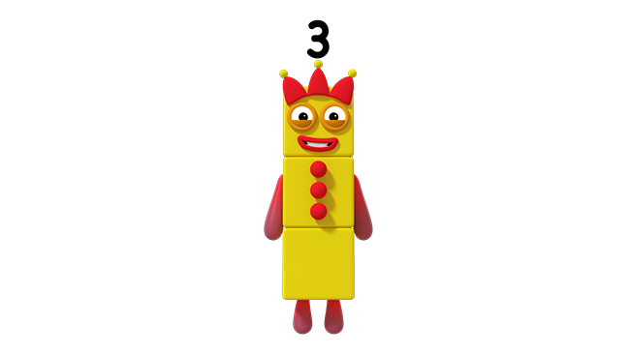
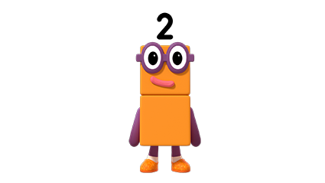
Images © 2017 Alphablocks Ltd. All Rights Reserved.
Notes:
This slide is animated:
What happened in the episode?
What did you notice?
Use your imagination – where could we send the Numberblocks for another adventure?
Sing the song: (the words are also on slide 10)
Off we go, on a big adventure, we don’t know what the day will bring
Off we go, on a big adventure, ready, steady, sing
One, two, three, four, five; that sounds right and off we go again.
Click 1: Numberblocks bounce off the screen to the left.
Click 2: Next screen and Numberblocks are shown in the wrong order.

Slide 9
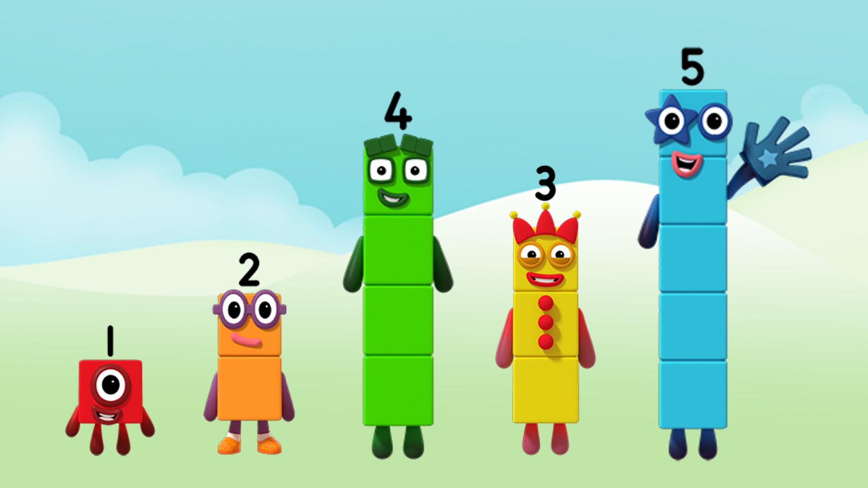
Images © 2017 Alphablocks Ltd. All Rights Reserved.
Notes:
Have a set of physical representations of the Numberblocks to order and reorder. Alternatively, 5 children could represent each of the Numberblocks with a numeral on their front. They mix themselves up and the other children give instructions to put them in the correct order.
Say together:
“The Numberblocks are in the wrong order”.
Ask the children to use the language of before and after to explain how to correct the line so that the Numberblocks go back in the right order:
“Two is just before Three”
“Three is just before Four”
“Four is just after Three”
“Three is just after Two”
Follow the children’s instructions with the Numberblocks - even if they provide unclear or incorrect instructions and keep checking by saying the counting words.

Slide 10
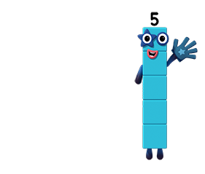
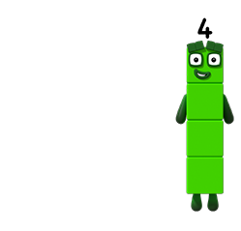
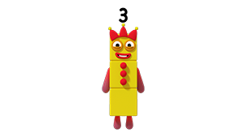
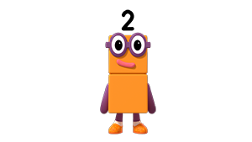
Off we go, on a big adventure
We don’t know what the day will bring.
Off we go, on a big adventure Ready, steady, sing:
That sounds right and off we go again.
Images © 2017 Alphablocks Ltd. All Rights Reserved.
Notes:
This slide supports the singing of the song. It is animated so that you can click for the numerals to appear as children sing them. This will support children’s recognition of numerals.

Slide 11
Enabling Environments

Slide 12
Enabling Environments
Playing and Exploring
Provide a feely bag of Numberblocks with five boxes for them to stand on. Suggest the children use their own mark making to record which Numberblock belongs on which box. Allow the children to explore feeling a Numberblock and identify which box it will go on before removing it.
Active Learning
Notice children often using a ‘lining up’ schema. If children are using this schema in their play, notice how they attend to placing the objects in a line and use that as an opportunity to describe how one thing is before or after another.
Creating and Thinking Critically Create an adventure scene for the Numberblocks. Retell a story about how the Numberblocks get muddled up and how they get back in the right order.

Slide 13
Learning Together in Y1

Slide 14
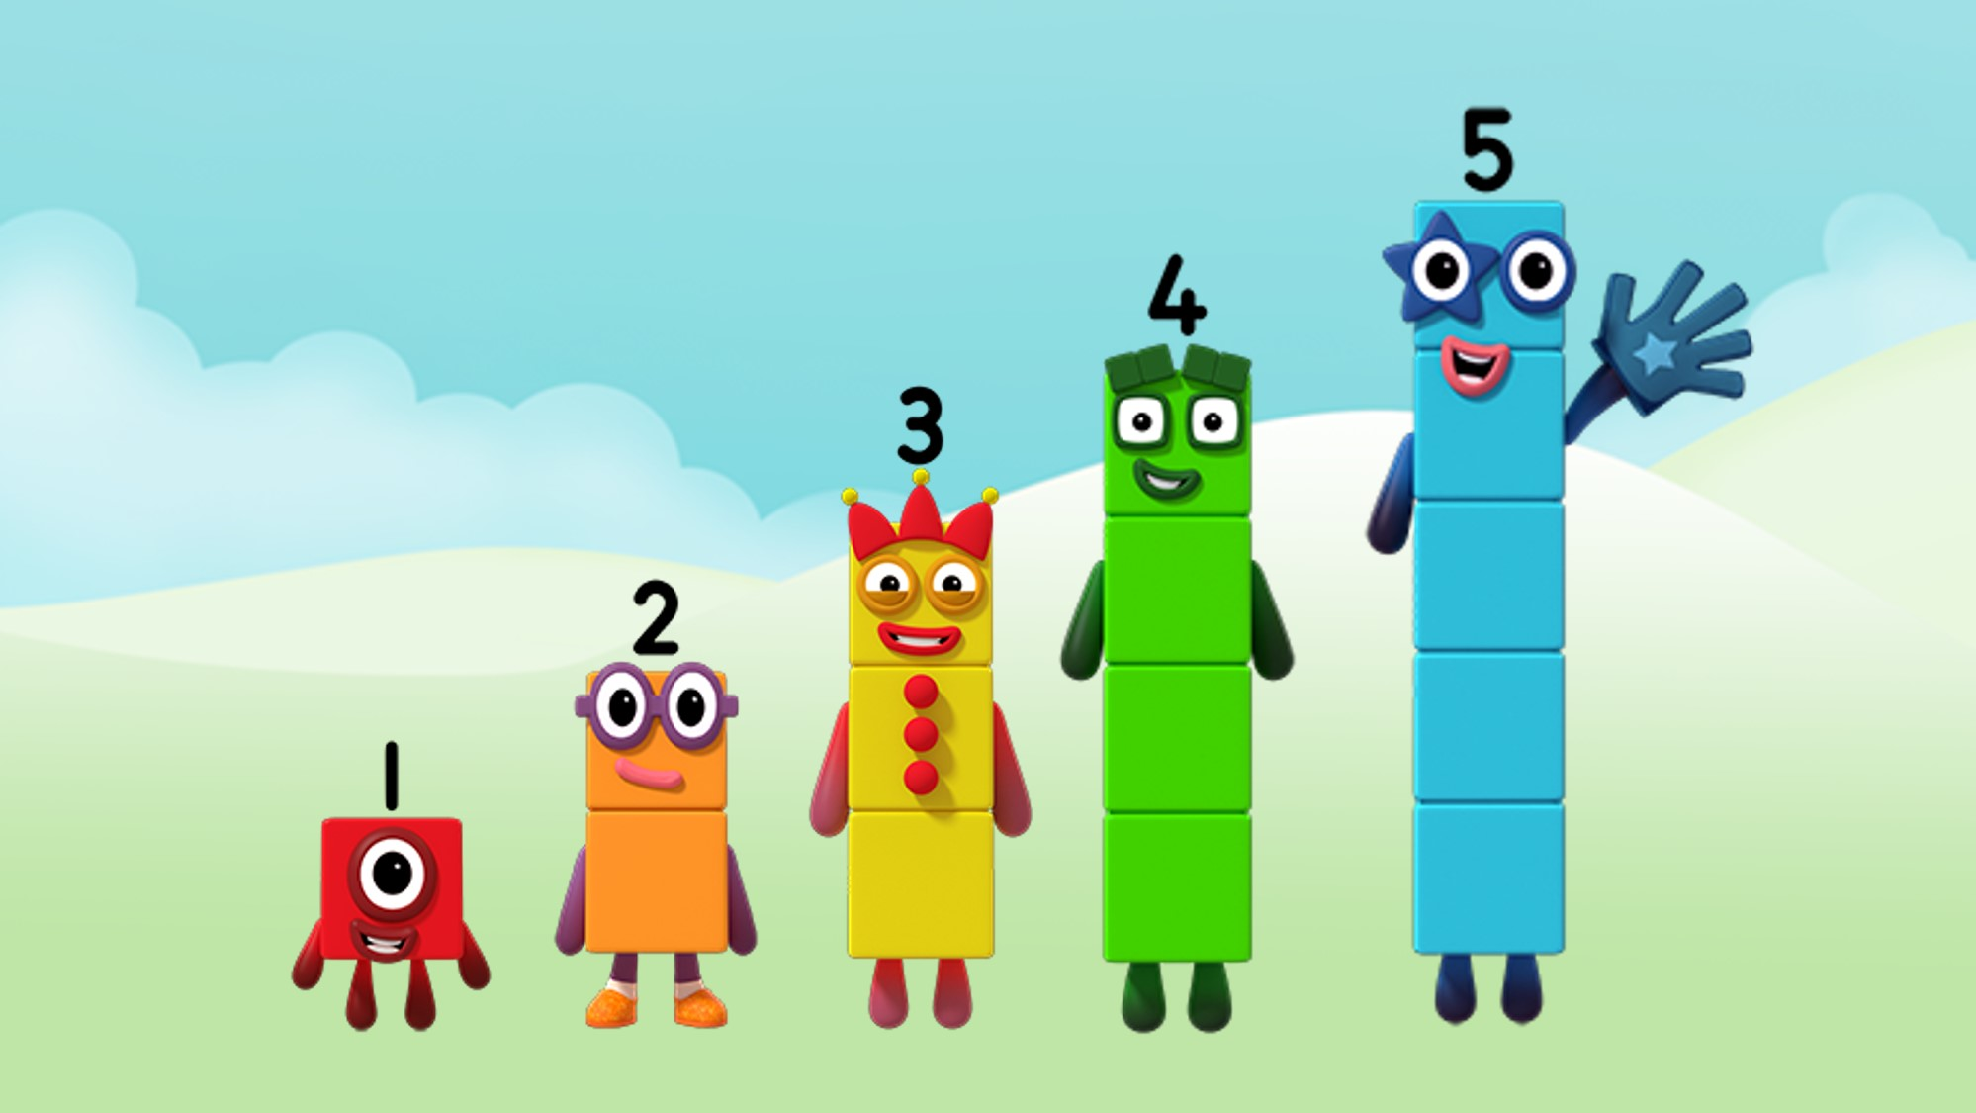
I am after Two.
I am before Two.
Images © 2017 Alphablocks Ltd. All Rights Reserved.
Notes:
This slide is animated:
Discuss the episode and what happened: the Numberblocks kept getting in the wrong order or a Numberblock would go missing.
Click 1: What is One saying?
Ask the children to discuss in pairs how the remaining Numberblocks would explain who they were next to, using the language of before and after.
Click 2: What is Three saying?
Ask the children to discuss in pairs how the remaining Numberblocks would explain who they were next to, using the language of before and after.
E.g. “Two is before Three and after One.”

Slide 15
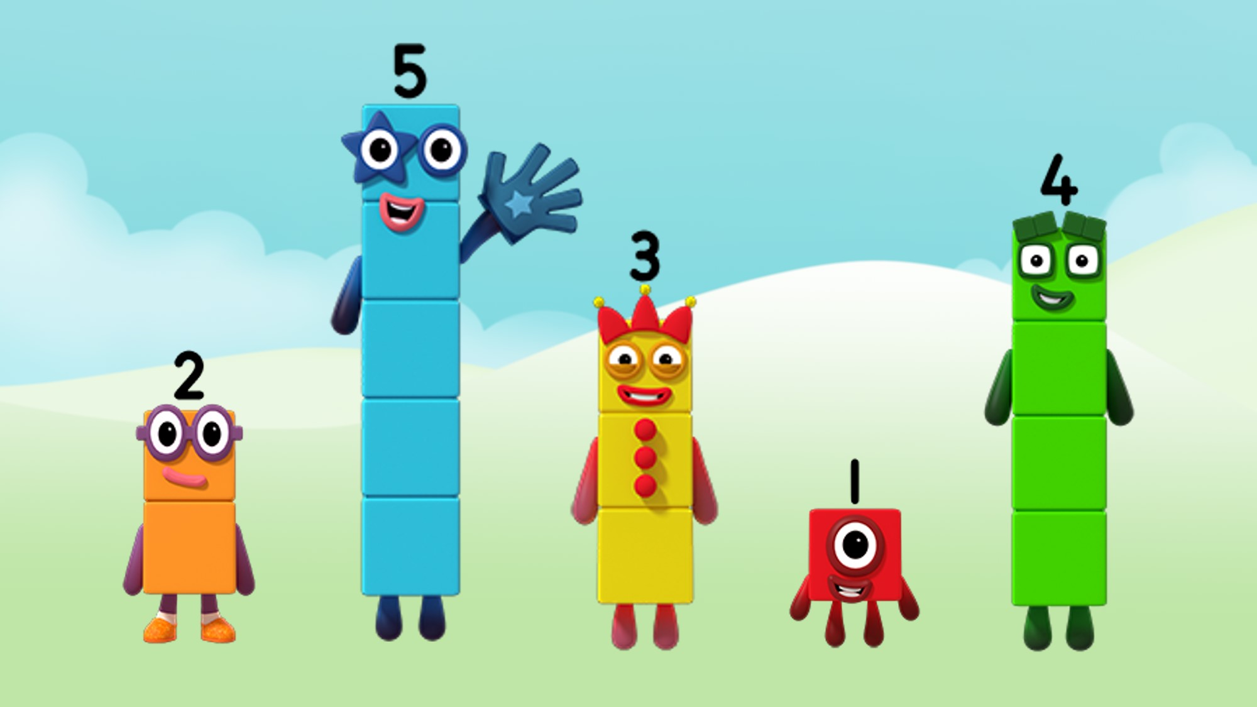
Images © 2017 Alphablocks Ltd. All Rights Reserved.
Notes:
Ask: What do you notice? Encourage the children to describe the present order using ‘before’ and ‘after’.
E.g “Five is after Two and before Three.”
Ask 5 children to come up to the front and give them 1-5 Numberblocks in the order in the slide. Ask the class to suggest a do-si-do for two children. Only two children can do-si-do at any one time.

Slide 16
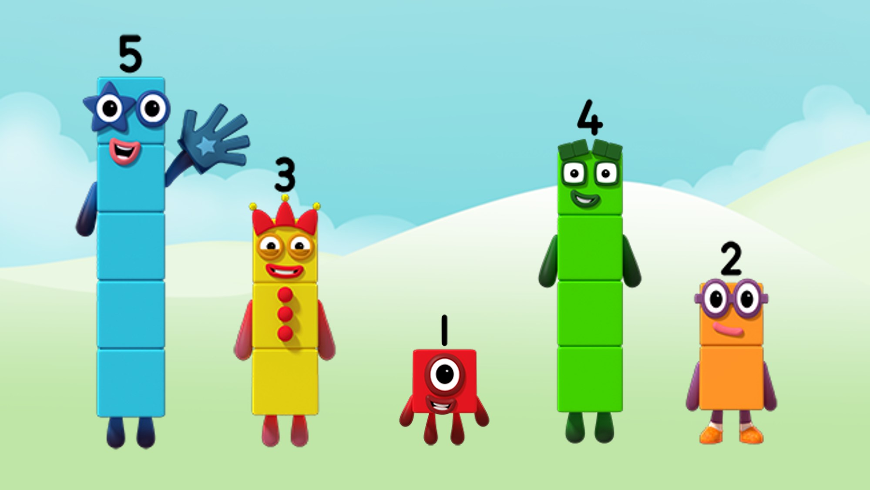
Images © 2017 Alphablocks Ltd. All Rights Reserved.
Notes:
Get the children into groups of 5 and give them each a Numberblock from 1-5 so every group has one of each. Ask them to get into the order on this slide. Set the challenge of finding a way to do-si-do back into the correct order. Can the children do it in more than one way? Which is the quickest way? You could play the Off We Go song in the background or do-si-do style music.

Slide 17
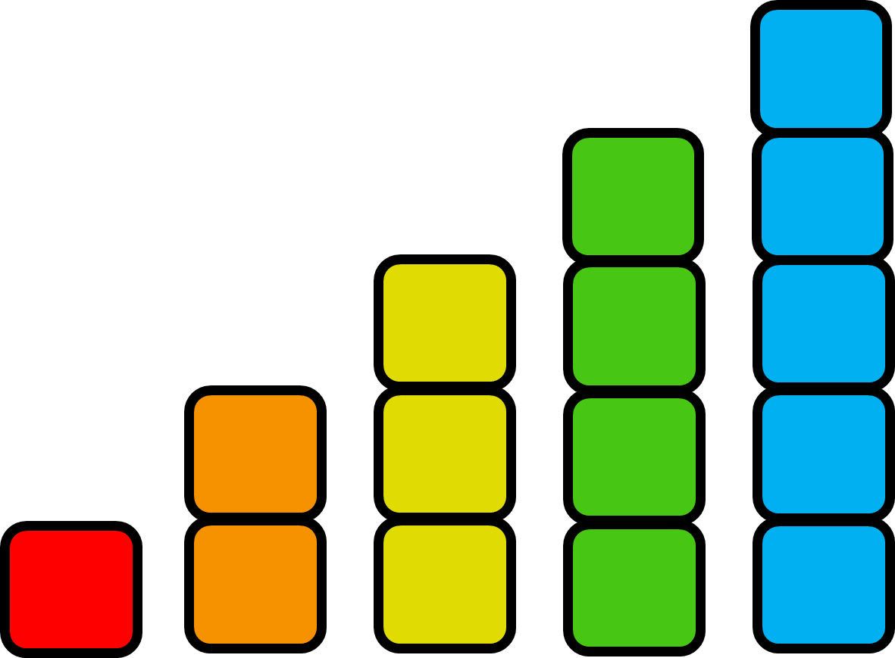
is before
is after
is before
and after
Notes:
Ask the children to suggest numbers that go into the missing box to make the sentence make sense.

Slide 18
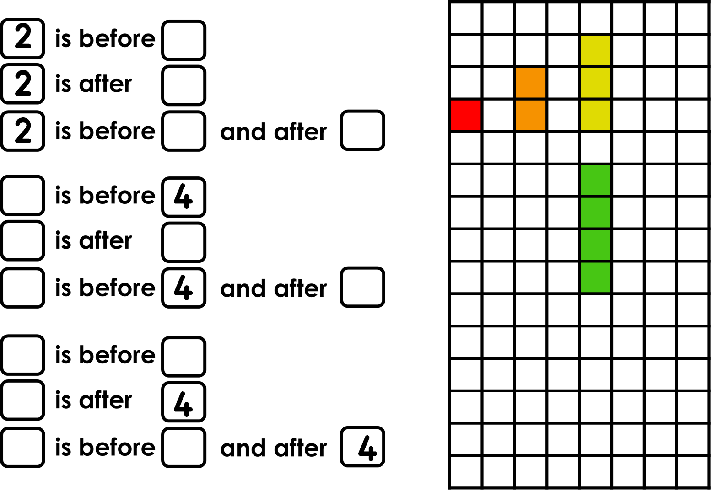
Notes:
Ask the children to work independently on these three tasks. Ask them to show how they know using squared paper.

Slide 19
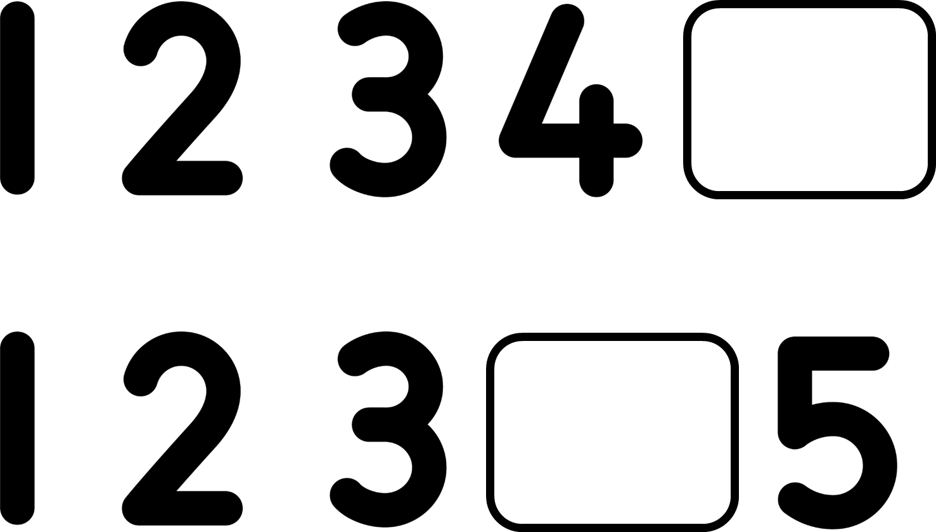
Notes:
Children discuss what number is missing from the sequence and why, using the language of before and after to justify their reasoning.

